Slide 1
Lecture 3 Terminated Transmission Line
1. Voltage, Current and Input Impedance of A Terminated Line
2. Input Reflection Coefficient and Input Impedance
3. Matched Load, Short-circuit Load and Open-circuit Load
4. Quarter-wave Transformer
5. Voltage Standing Wave Ratio
6. Transmission Line with A Source and A Load
7. Reflected Power and Delivered Power
8. Code Example

Slide 2
1. Voltage, Current and Input Impedance of A Terminated Line
Terminating impedance (load)
Ampl. of voltage wave propagating in positive z direction at z = 0.
Ampl. of voltage wave propagating in negative z direction at z = 0.

Slide 3
Understanding the wave propagation

Slide 4

Voltage and current:
Terminating impedance (load)
What is V(-l )?
l ≡ distance away from load
propagating forwards
propagating backwards
The current at z = - l is then
from

Slide 5
Load reflection coefficient:
Total volt. at distance l from the load
Ampl. of volt. wave prop. towards load, at the load position (z = 0).
Ampl. of volt. wave prop. away from load, at the load position (z = 0).
Γ_{L} ≡ Load reflection coefficient
Γ_{l} ≡ Reflection coefficient at z = - l
Similarly,

Slide 6
Input impedance:
Input impedance seen “looking” towards load at z = -l .

Slide 7
At the load (l = 0):
Reflection Coefficient

Slide 8
At the load (l = 0):
Recall
Thus,

Slide 9
Simplifying, we have
sinh: 싸인에이취
Hence, we have

Slide 10
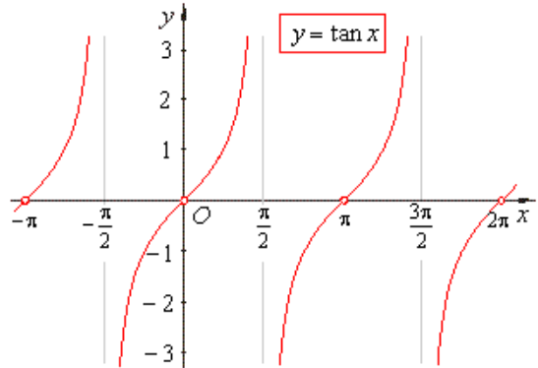
Impedance is periodic with period λ_{g}/2
tan repeats when
Note:

Slide 12
For the remainder of our transmission line discussion we will assume that the transmission line is lossless.

Slide 13
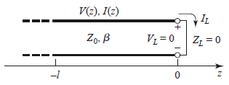
2. Input Impedance and Input Reflection Coefficient

Slide 14
Execise:
The reflection coefficient at the load is given by Γ_{L} = 0.8 e ^{j45°}. The line is lossless and has characteristic impedance of 50 Ω.
1) Find the reflection coefficient at 0.2λ_{g} away from the load.
2) Find the input impedance at 0.2λ_{g} away from the load.
(Solution)

Slide 15
Example: Reflectioin coefficient and input impedance of a terminated transmission line
Transmission line length L = 0.1 λ_{g} ; Load impedance Z_{L} = 40 + j 70 Ω
Characteristic impedance Z₀ = 50 Ω
1) Find the input reflection coefficient.
2) Fint the input impedance from the reflection coefficient.
3) Find the input impedance using Z_{L} and L.
(Solution)

Slide 16
3. Matched Load, Short-circuit Load, and Open-circuit Load
A
Matched load: (Z_{L}=Z₀)
No reflection from the load
For any l

Slide 17
Short-circuit Load → Inductor
B
Short circuit load: (Z_{L} = 0)
Note:
Always imaginary!
S.C. can become an O.C. with a λ_{g}/4 trans. line

Slide 18
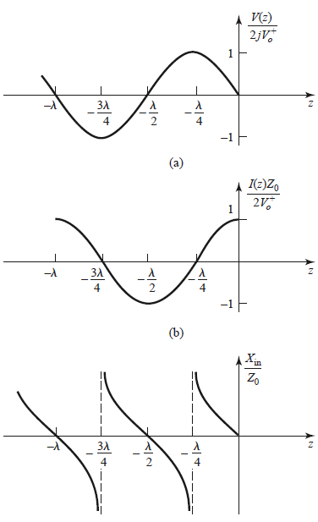
Short-circuit Load

Slide 19
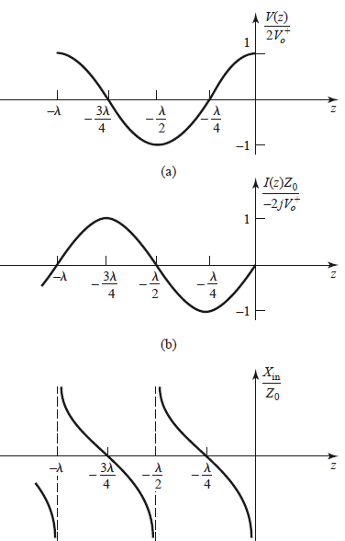
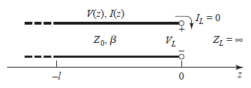
Open-circuit Load → Capacitor

Slide 20
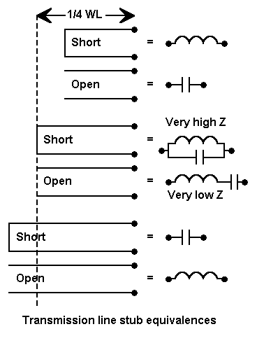
Transmission Line Stub Equivalence

Slide 21
Z₀ from Short and Open Circuit Tests

Slide 22
Example: Short-open test of a transmission line
f = 10 MHz, transmission line length L = 2 m
Open-circuit input impedance Z_{S} = j 36 ; Short-circuit input impedance Z_{O} = −j 69
Find Z₀ and β, λ_{g}, ε_{r} the line.
(Answer)

Slide 23
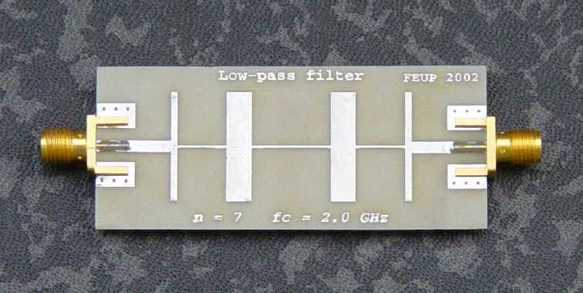
Using Transmission Lines to Synthesize Loads
This is very useful is microwave engineering.
A microwave filter constructed from microstrip.

Slide 24
Exercise:
f = 300 MHz
Transmission line: length = 0.1 λ_{g}, Z₀ = 50 Ω
1) Find the equivalent capacitance of an open-circuit transmission line.
2) Find the equivalent inductance of a short-circuit transmission line.
(Solution)

Slide 25
4. Quarter-wave Transformer
Z₀
Z_{0T}
Z_{L}
Z_{in}
This requires Z_{L} to be real.
so
Hence

Slide 26
Exercise:
A load with impedance Z_{L} = 20 Ω is connected to a quarter-wave transformer
with propagation constant β = 4π rad/m and characteristic impedance Z₀ for
matching with a source impedance of 75 Ω. Find the length and characteristic
impedance of the quarter-wave transformer
(Solution)

Slide 27
5. Voltage Standing Wave Ratio

Slide 28
Exercise:
A load with impedance Z_{L} = 20 −j 20 Ω is connected to a transmission line with
characteristic impedance Z₀ = 50 Ω. Find the VSWR on the transmission line.
(Solution)

Slide 29
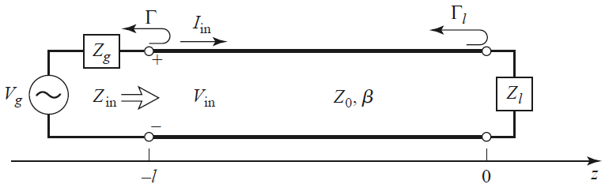
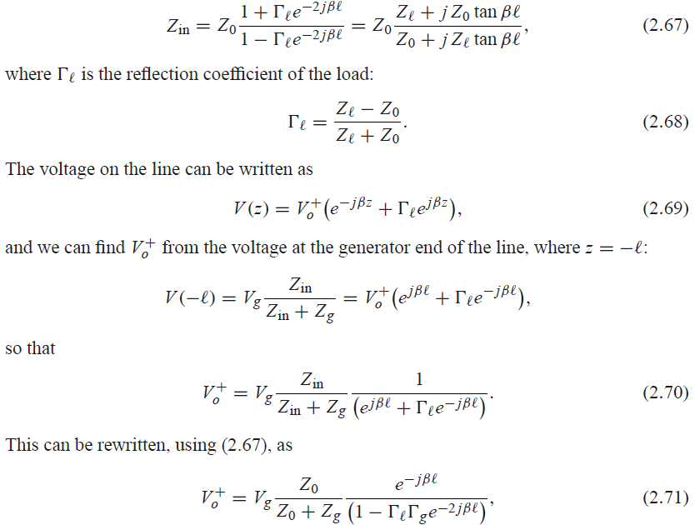
6. Transmission Line with A Source and A Load

Slide 30
Exercise:
A load with impedance Z_{L} = 20 −j 20 Ω is connected to a transmission line whose
length is 0.2 wavelength and whose characteristic impedance Z₀ is 50 Ω. The other
end of the transmission line is connected to a voltage source V_{s} = 10e ^{j45°} with
internal impedance Z_{s} of 40+j60 Ω.
1) Find the voltage at the input of the transmission line.
2) Find the voltage at the load.
3) Find the power dissipated at the load.
(Solution)

Slide 32



7. Reflected Power and Delivered Power

Slide 33
Exercise:
A load with impedance Z_{L} = 20 −j 20 Ω is connected to a transmission line with
characteristic impedance Z₀ = 50 Ω. A voltage of 20e ^{j45°} is incident on the load.
1) Find the power P_{i} incident on the load.
2) Find the power P_{r} reflected from the load.
3) Find the power P_{L} delivered to the load.
(Solution)

Slide 34
8. Code Example

Slide 35
# Microwave Engingineering, Lecture 2 Python Code
# Terminated transmission line: input reflection coefficient and input impedance
# Sample values:
# Input: RL=40, XL=40, L=0.1 wavelenth
# Output:
#
import cmath
import math
pi=3.14159265
while True:
RL=float(input('RL (ohm)='))
XL=float(input('XL (ohm)='))
Z0=float(input('Z0 (ohm)='))
L=float(input('L (wavelength)='))
j=complex(0.,1.)
ZL=complex(RL, XL)
GL=(ZL-Z0)/(ZL+Z0)
Gin=GL*cmath.exp(-j*2*2*pi*L)
Gin_mag, Gin_phase=cmath.polar(Gin)
Gin_dB=20*math.log(Gin_mag)
Zin=Z0*(1+Gin)/(1-Gin)
print('Input reflection coeffcient: mag, phase(deg)=',Gin_mag, Gin_phase)
print('Input reflection coefficint (dB)=',Gin_dB)
print('Zin=',Zin)

Slide 36
'''
RL (ohm)=
20
XL (ohm)=
50
Z0 (ohm)=
50
L (wavelength)=
0.2
Input reflection coeffcient: mag, phase(deg)= 0.677834389404565 -1.022307778917341
Input reflection coefficint (dB)= -7.7770456858800845
Zin= (35.91076216402567-76.8526053239948j)
RL (ohm)=
'''

Slide 37


