Slide 1
Lecture 11 Maxwell's Equations
1. Maxwell's Equations
2. Power and Energy in Electromagnetic Fields
3. Poynting's Theorem
4. Impedance and Admittance
5. Wave Equation
6. Planewave
7. Coding Example

Slide 2
1. Maxwell's Equations
Maxwell's equations (ME)
Materials electrical properties
ME in terms of E and H

Slide 3
Sinusoidal field
ME in phasor form

Slide 4
2. Power and Energy in Electromagnetic Fields
Power in terms of voltage and current

Slide 5
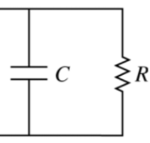
Power loss in dielectric materials

Slide 6
Complex permittivity and electric loss tangent

Slide 7
Power loss in magnetic materials

Slide 8
Complex permeability and magnetic loss tangent

Slide 9
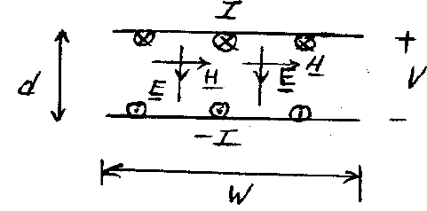
Power density of electromagnetic fields
- Use an ideal parallel-plate capacitor to understand the concept

Slide 10
Stored energy in electric field

Slide 11
Stored energy in magnetic field

Slide 12
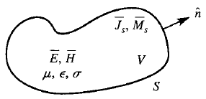
3. Poynting's Theorem
Power balance equation in electromagnetic field

Slide 13
4. Impedance and Admittance
Impedance and admittance in terms of terminal current and terminal voltage

Slide 14
5. Wave Equation
Electromagnetic field in charge-free region

Slide 15
6. Planewave
Planewave: one-dimensional wave

Slide 16
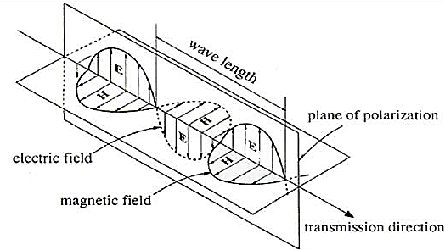
Intrinsic impedance

Slide 17
7. Coding Example
Planewave
Input: f, u_{r}, ε_{r}
Calculate: k, λ, η

