Slide 1
Transmission Lines 1

Slide 2
Transmission-Line Theory
We need transmission-line theory whenever the length of a line is significant compared to a wavelength.

Slide 3
Transmission Line
2 conductors: c1=signal, c2=ground
4 per-unit-length parameters:
C = capacitance/length [F/m]
L = inductance/length [H/m]
R = resistance/length [Ω/m]
G = conductance/length [ /m or S/m]
Δz
Ω

Slide 4
Transmission Line (cont.)
x
x
x
+ + + + + + +
B
- - - - - - - - - -
+
+
-
-
Note: There are equal and opposite currents on the two conductors.
(We only need to work with the current on the top conductor, since we have chosen to put all of the series elements there.)

Slide 5
Transmission Line (cont.)
+
+
-
-

Slide 6
TEM Transmission Line (cont.)
Hence
Now let Δz → 0:
“Telegrapher’sEquations”

Slide 7
TEM Transmission Line (cont.)
To combine these, take the derivative of the first one with respect to z:
Switch the order of the derivatives.

Slide 8
TEM Transmission Line (cont.)
Hence, we have:
The same differential equation also holds for i.
Note: There is no exact solution in the time domain, in the lossy case.

Slide 9
TEM Transmission Line (cont.)
Time-Harmonic (=Sinusoidal) Waves:

Slide 10
TEM Transmission Line (cont.)
Note that
Then we can write:

Slide 11




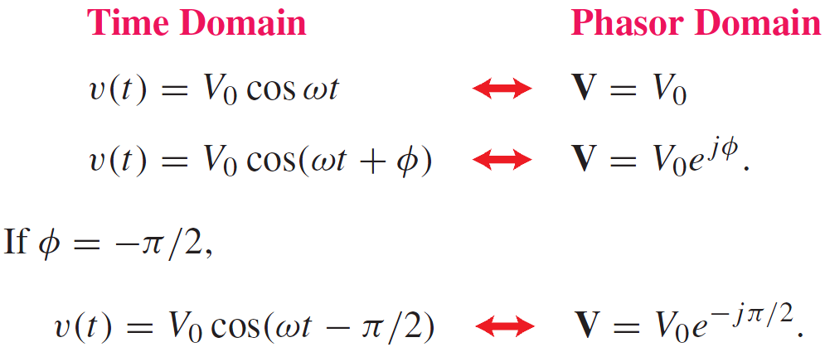
Phasor Domain
Phasor counterpart of

Slide 12
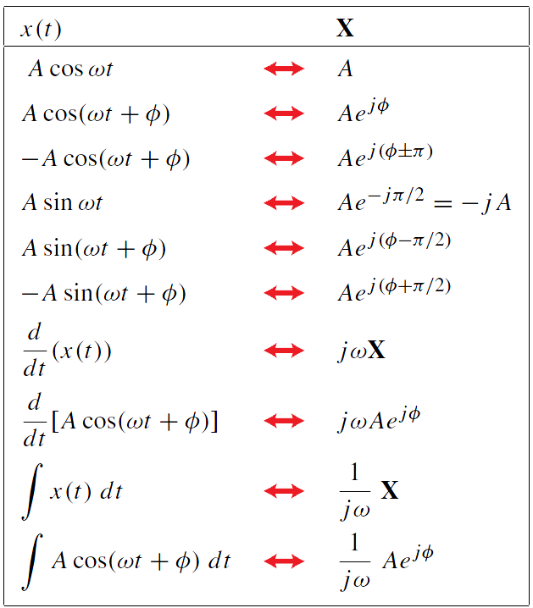
Time and Phasor Domain
It is much easier to deal with exponentials in the phasor domain than sinusoidal relations in the time domain
Just need to track magnitude/phase, knowing that everything is at frequency ω

Slide 13
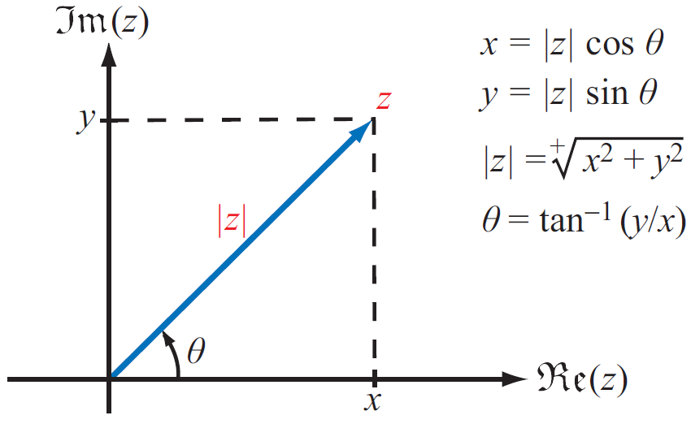
Complex Numbers
We will find it is useful to represent sinusoids as complex numbers
Rectangular coordinates
Polar coordinates
Relations based on Euler’s Identity

Slide 14
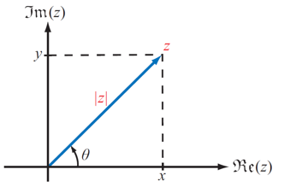
Complex Numbers
Rectangular to Polar Conversion

Slide 15
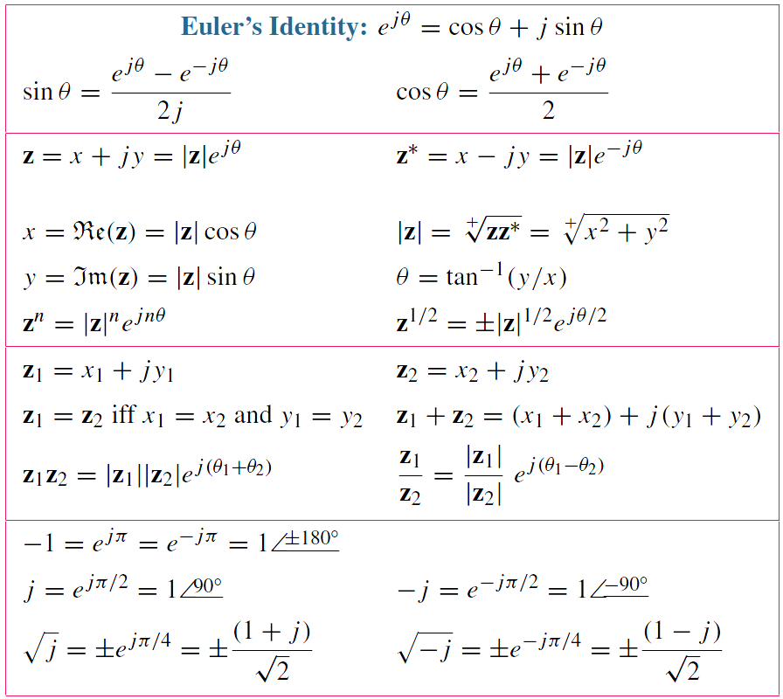
Relations for Complex Numbers
Learn how to perform these with your calculator/computer

Slide 16
TEM Transmission Line (cont.)
Define
Then
Solution:
γ is called the “propagation constant”.
We have:
Question: Which sign of the square root is correct?

Slide 17
TEM Transmission Line (cont.)
We choose the principal square root.
Principal square root:
(Note the square-root (“radical”) symbol here.)
Hence

Slide 18
TEM Transmission Line (cont.)
Denote:

Slide 19
TEM Transmission Line (cont.)
Wave traveling in +z direction:
Wave is attenuating as it propagates.
Wave traveling in −z direction:
Wave is attenuating as it propagates.

Slide 20
TEM Transmission Line (cont.)
Attenuation in dB/m:

Slide 21
Wavenumber Notation

Slide 22
TEM Transmission Line (cont.)
Forward travelling wave (a wave traveling in the positive z direction):
The wave “repeats” when:
Hence:
“snapshot” of wave

Slide 23
Phase Velocity
Let’s track the velocity of a fixed point on the wave (a point of constant phase), e.g., the crest of the wave.
(phase velocity)

Slide 24
Phase Velocity (cont.)
Set
Hence

Slide 25
Characteristic Impedance Z₀
Assumption: A wave is traveling in the positive z direction.
so
(Note: Z₀ is a number, not a function of z.)

Slide 26
Characteristic Impedance Z₀ (cont.)
Use first Telegrapher’s Equation:
so
Recall:
Hence

Slide 27
Characteristic Impedance Z₀ (cont.)
From this we have:
Use:
Both are in the first quadrant
(principal square root)

Slide 28
Characteristic Impedance Z₀ (cont.)
Hence, we have

Slide 29
RLGC from Z₀ and γ

Slide 30
General Case (Waves in Both Directions)
Wave in +z direction
Wave in -z direction
In the time domain:

Slide 31
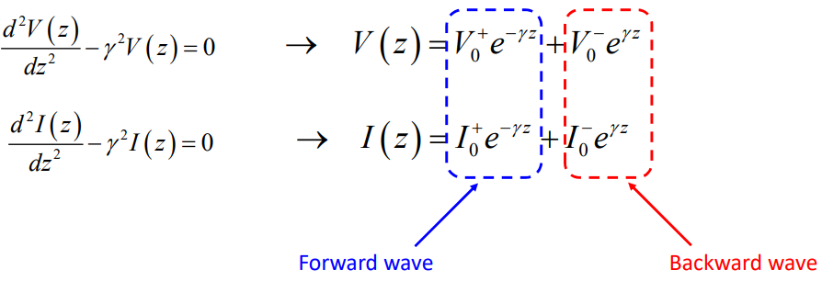
Backward and Forward Waves

Slide 32
Backward-Traveling Wave
z
A wave is traveling in the negative z direction.
so
Note:
The reference directions for voltage and current are chosen the same as for the forward wave.

Slide 33
General Case
z
Most general case:
A general superposition of forward and backward traveling waves:

Slide 34
Summary of Basic TL formulas
Guided wavelength:
Phase velocity:

Slide 35
Small Loss Case

Slide 36
Lossless Case
so
(real and independent of freq.)
(independent of freq.)

Slide 37
Lossless Case (cont.)
If the medium between the two conductors is lossless and homogeneous (uniform) and is characterized by (ε, μ), then (proof given later):
(proof given later)
The speed of light in a dielectric medium is
Hence, we have that:
and
In the lossless case the phase velocity does not depend on the frequency, and it is always equal to the speed of light (in the material).

Slide 38
L, Z₀ from C
(proof given later)

Slide 39
Distortionless Line
(proof given later)

Slide 40
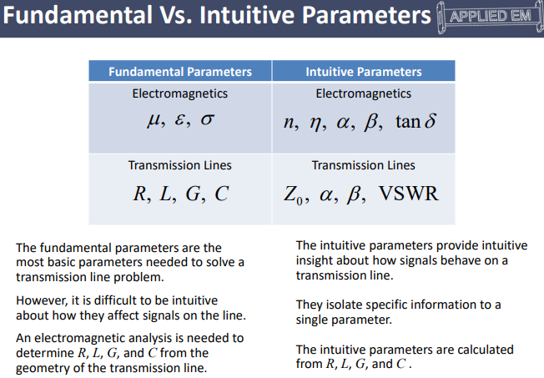
(proof given later)

Slide 41
Square Root of Complex Numbers
Square Root of A Complex Number:

Slide 42
Square Root of Complex Numbers
Square Root of An Inverse of A Complex Number:
Square Root of A Producto of Two Complex Numbers:

Slide 43
Square Root of Complex Numbers
Square Root of A Radio of Two Complex Numbers:

Slide 44
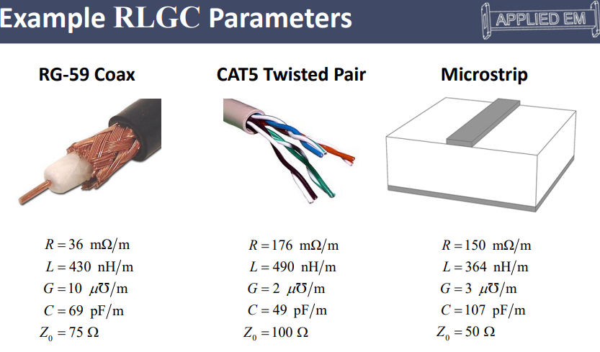
(proof given later)

Slide 45
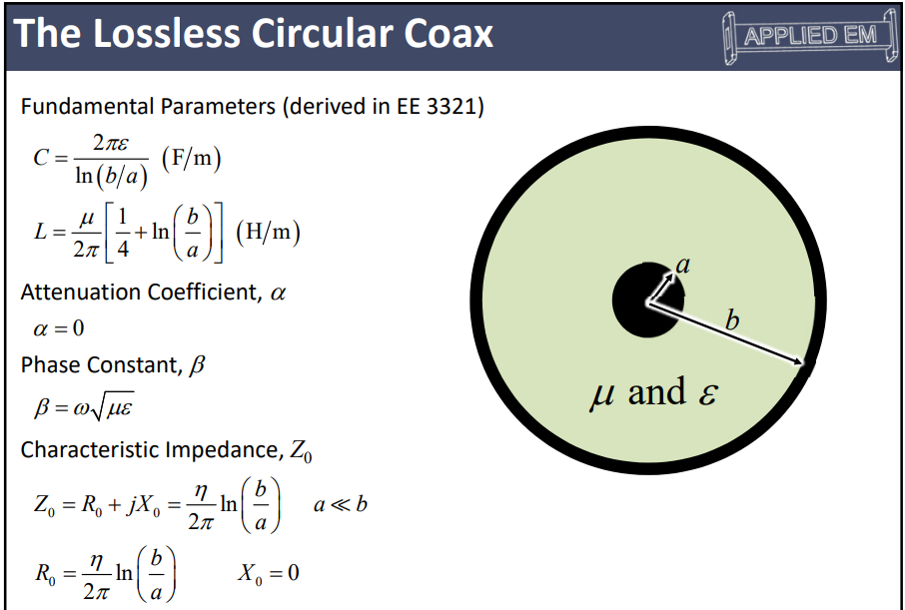
(proof given later)

Slide 46
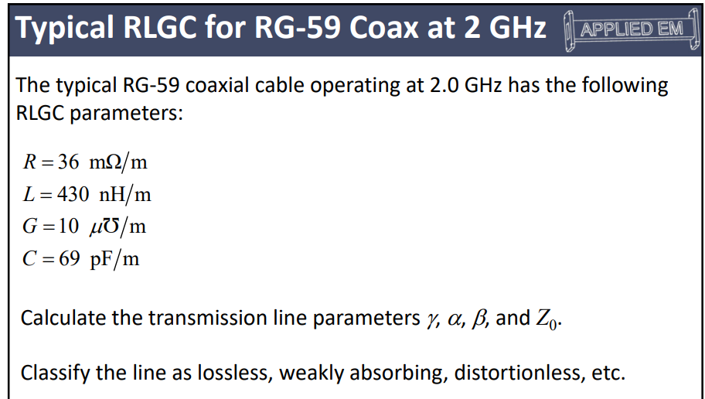
(proof given later)

Slide 47
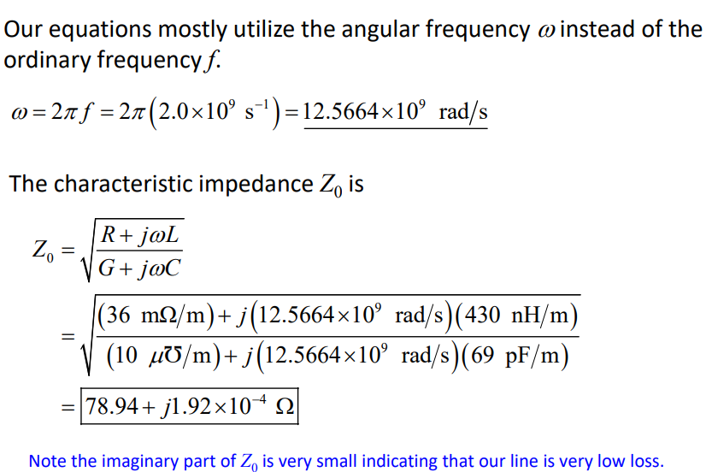
(proof given later)

Slide 48
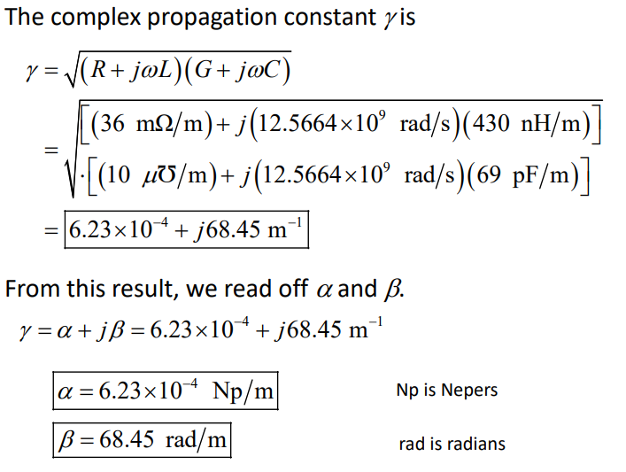
(proof given later)

Slide 49
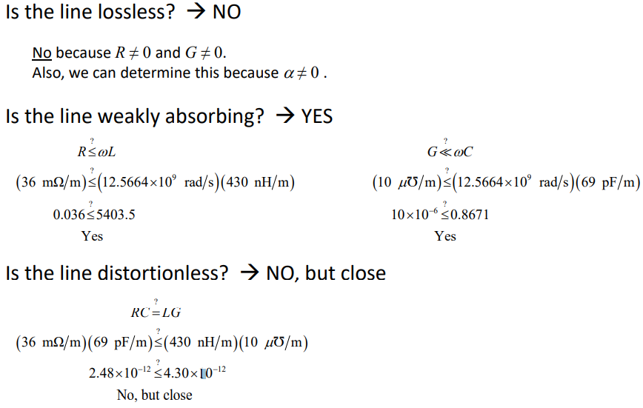
(proof given later)

Slide 50
01-Python: Z0,gamma from R,L,G,C
# Transmission Line: Z0,gamma from R,L,G,C
# Sample values: RG-59 coaxial cable
# Input: R=36e-3 ohm/m, L=430e-9 H/m, G=10e-6 S/m, C=69e-12 F/m, f=100e6 Hz
# Output:
# Z0=(78.94228228730861+0.0038450155279376556j)
# gamma=(0.0006227261020735598+3.4224620530010226j)
import cmath
pi=3.14159265
while True:
R=float(input('R(ohm/m)='))
L=float(input('L(H/m)='))
G=float(input('G(S/m)='))
C=float(input('C(F/m)='))
while True:
f=float(input('f(Hz)=(negative to stop)'))
if f < 0:
break
Z=complex(R,2*pi*f*L); Y=complex(G,2*pi*f*C)
Z0=cmath.sqrt(Z/Y); gamma=cmath.sqrt(Z*Y)
print('Z0(ohm)=',Z0)
print('gamma(per meter)=',gamma)
(proof given later)

Slide 51
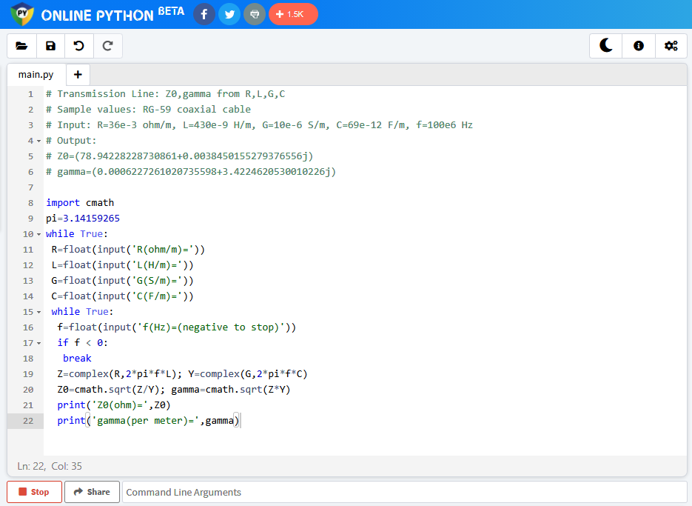
https://www.online-python.com/ 에 접속하여 소스코드를 위 창에 copy
[Run]아이콘 클릭
아래 창에 데이터 입력 prompt가 표시되면 키보드로 데이터 입력
출력은 아래 창에 표시됨.
(proof given later)

Slide 52
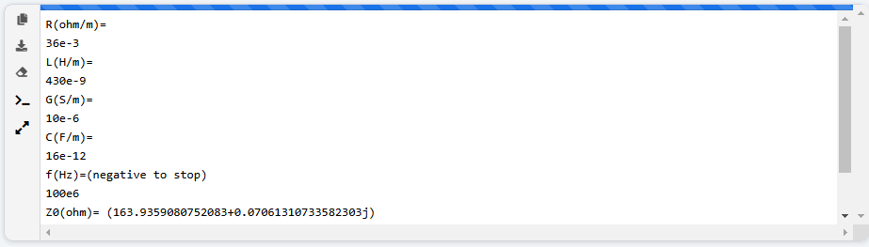
(proof given later)

Slide 53

Python cmath 모듈 확인
- 구글에서 python cmath modules 입력
- 결과 중에서 적절한 것을 선택하여 열어 봄.
(proof given later)

Slide 54


