Slide 1
Chungbuk National University - 충북대학교
4G LTE USB Modem and
LTE Network
Teaching assistant: 배일호
2023. 06.03

Slide 2
Contents
Introduction to 4G LTE USB Modem and LTE Network
Advantages of 4G LTE Network
Features of 4G LTE USB Modem
Applications of 4G LTE USB Modem
Security and Privacy Considerations of 4G LTE Network
Easy to Use
Conclusion

Slide 3
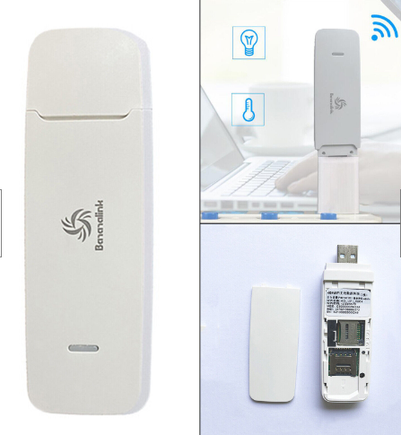
1. Introduction to 4G LTE USB Modem and LTE Network
The fourth generation (4G) Long-Term Evolution (LTE) network is a wireless communication technology that offers high-speed internet connectivity. It is designed to provide faster data transfer rates, lower latency, and better network coverage compared to its predecessors
4G LTE USB Modem
Notes:
Introduction to 4G LTE USB Modem and LTE Network
The fourth generation (4G) Long-Term Evolution (LTE) network is a wireless communication technology that offers high-speed internet connectivity. It is designed to provide faster data transfer rates, lower latency, and better network coverage compared to its predecessors.
A 4G LTE USB modem is a portable device that allows users to connect to the internet using the LTE network. It is a plug-and-play device that can be used on any computer or laptop with a USB port.

Slide 4
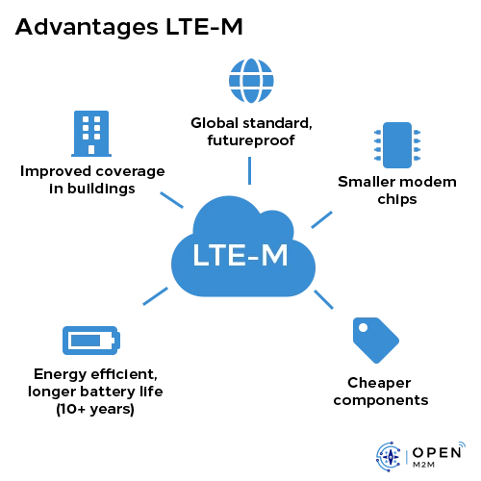
2. Advantages of 4G LTE Network
Notes:
One of the main advantages of the 4G LTE network is its speed. It offers download speeds of up to 100 Mbps and upload speeds of up to 50 Mbps, which is significantly faster than 3G networks.
Another advantage of the 4G LTE network is its low latency. This means that there is less delay in data transmission, resulting in a smoother and more responsive user experience.

Slide 5
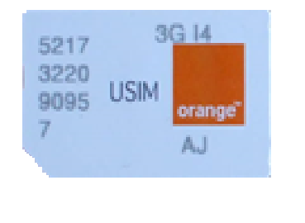
3. Features of 4G LTE USB Modem
A 4G LTE USB modem typically comes with a built-in SIM card slot, which allows users to access the LTE network without the need for additional hardware. It also supports multiple frequency bands, making it compatible with different LTE networks around the world.
Notes:
A 4G LTE USB modem typically comes with a built-in SIM card slot, which allows users to access the LTE network without the need for additional hardware. It also supports multiple frequency bands, making it compatible with different LTE networks around the world.
Most 4G LTE USB modems are also equipped with a microSD card slot, which allows users to store and transfer data. Some models also come with built-in Wi-Fi, allowing users to share their internet connection with other devices.

Slide 6
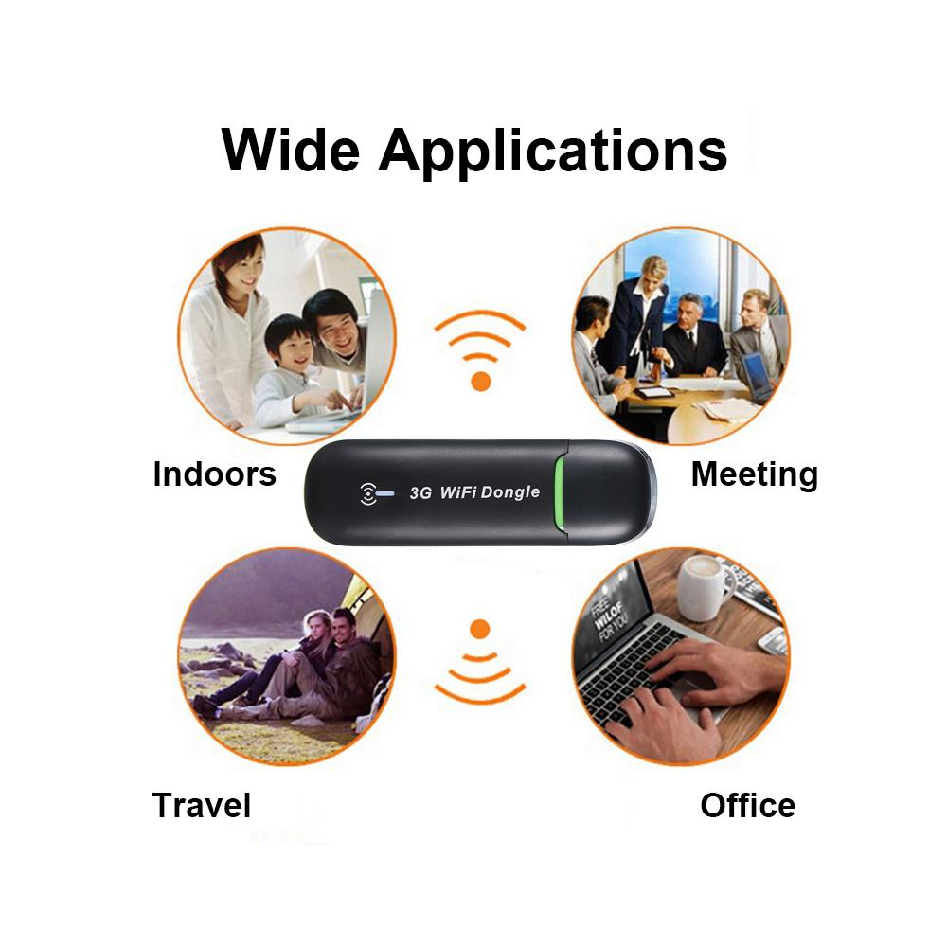
4. Applications of 4G LTE USB Modem
A 4G LTE USB modem can be used in various settings, such as homes, offices, and outdoor locations. It is particularly useful for people who need to work remotely or travel frequently.
Some common applications of 4G LTE USB modems include video conferencing, online gaming, streaming high-definition videos, and downloading large files.
Notes:
A 4G LTE USB modem can be used in various settings, such as homes, offices, and outdoor locations. It is particularly useful for people who need to work remotely or travel frequently.
Some common applications of 4G LTE USB modems include video conferencing, online gaming, streaming high-definition videos, and downloading large files.

Slide 7
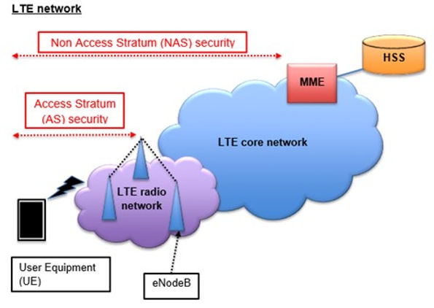
5. Security and Privacy Considerations of 4G LTE Network
Notes:
While the 4G LTE network offers many benefits, it also poses certain security and privacy risks. For example, hackers can intercept data transmissions and steal sensitive information, such as passwords and credit card numbers.
To mitigate these risks, it is important to use strong passwords, enable two-factor authentication, and avoid connecting to public Wi-Fi networks. It is also recommended to use a virtual private network (VPN) to encrypt data transmissions and protect privacy.

Slide 8
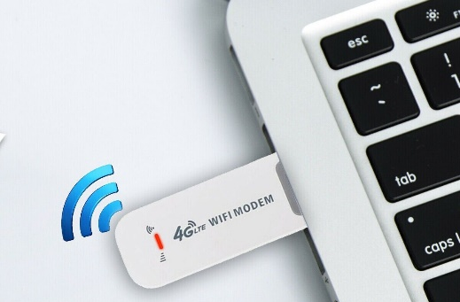
6. Easy to Use
1
2
Setting up your 4G LTE USB modem is easy! First, insert the SIM card provided by your cellular network provider into the modem. Next, connect the modem to your device using a USB cable. Finally, install any necessary drivers or software provided by the manufacturer.
Notes:
Setting up your 4G LTE USB modem is easy! First, insert the SIM card provided by your cellular network provider into the modem. Next, connect the modem to your device using a USB cable. Finally, install any necessary drivers or software provided by the manufacturer.

Slide 9
7. Conclusion
In conclusion, the 4G LTE USB modem is an essential tool for anyone who needs a fast, reliable, and secure internet connection on-the-go. Whether you're traveling, working remotely, or just need a backup internet connection, this device can provide you with the connectivity you need.
So why not give it a try? With its numerous benefits and easy setup process, the 4G LTE USB modem is a must-have for anyone who values staying connected in today's digital world.
Notes:
In conclusion, the 4G LTE USB modem is an essential tool for anyone who needs a fast, reliable, and secure internet connection on-the-go. Whether you're traveling, working remotely, or just need a backup internet connection, this device can provide you with the connectivity you need.
So why not give it a try? With its numerous benefits and easy setup process, the 4G LTE USB modem is a must-have for anyone who values staying connected in today's digital world.

Slide 10
Thank you for your consideration

Slide 11
7. Future of 4G LTE Network and USB Modem
The 4G LTE network is expected to continue evolving in the coming years, with the introduction of new technologies such as 5G and edge computing. These advancements will offer even faster speeds, lower latency, and more reliable connectivity.
Similarly, 4G LTE USB modems are likely to become more compact, powerful, and versatile. They may also incorporate new features such as artificial intelligence and machine learning, enabling them to adapt to users' needs and preferences.
Notes:
The 4G LTE network is expected to continue evolving in the coming years, with the introduction of new technologies such as 5G and edge computing. These advancements will offer even faster speeds, lower latency, and more reliable connectivity.
Similarly, 4G LTE USB modems are likely to become more compact, powerful, and versatile. They may also incorporate new features such as artificial intelligence and machine learning, enabling them to adapt to users' needs and preferences.

