Slide 1
Chungbuk National University - 충북대학교
LoRa
Teaching assistant: 배일호
2023. 05.20

Slide 2
Contents
Block diagram
Hardware
Principle of operation
Code and code description

Slide 3
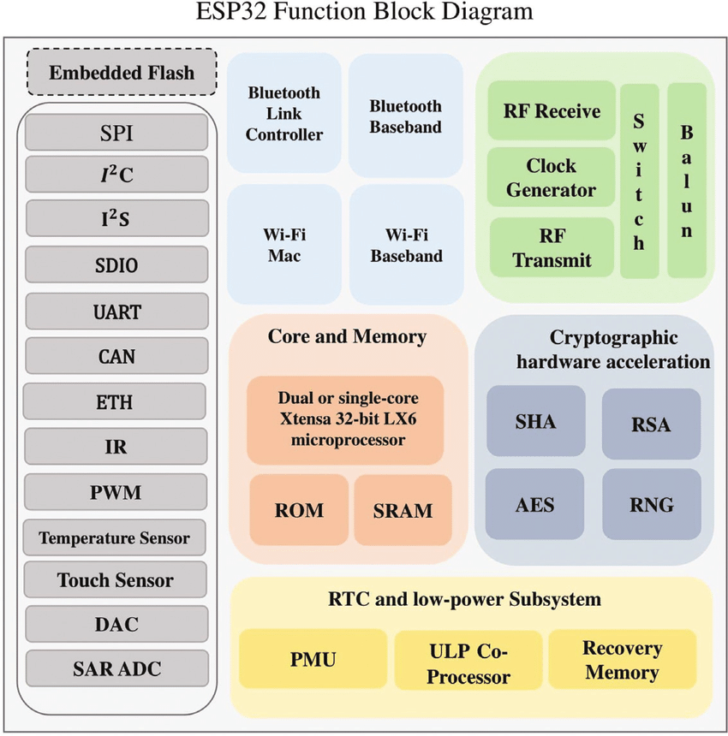
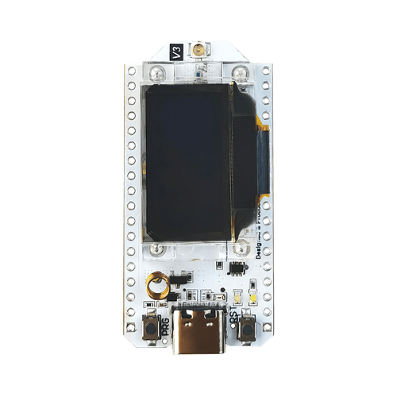
2. Block diagram
ESP32 V3 board
Block diagram of ESP32S3
Notes:
This is ESP32 V3 board
This board include esp32 chip
This is esp32 chip function block diagram.
This chip includes Bluetooth, wifi, embedded flash, RTC, and low power subsystem

Slide 4
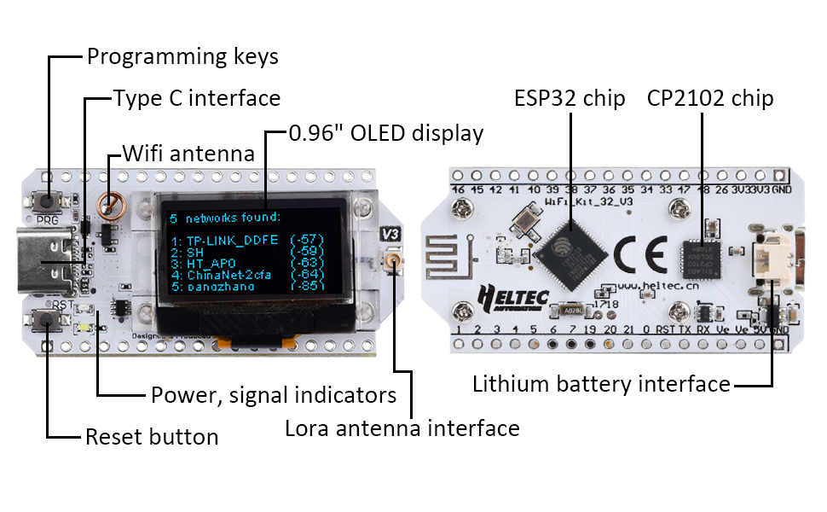
2. Hardware
Description of ESP32 v3 board
Notes:
Today we are going to use this board to test LoRa
This board includes esp32 chip, cp2102 chip, reset button, power and signal indicators, OLED diplay ,type C interface and sx1262 LoRa chip

Slide 5
2. Hardware
something to use
Notes:
We need these things to test ESP p2p
Arduino IDE, 2 pieces of esp32v3 board
we are going to program this board using arduino IDE

Slide 6
4. Principle of operation
LoRa
LoRa (Long Range) is a wireless communication technology designed for long-range and low-power applications, such as IoT devices. It uses a unique modulation technique called Chirp Spread Spectrum (CSS) to transmit data over long distances while conserving battery life.
In a LoRa network, there are two main components: end devices and gateways. End devices, such as sensors or IoT devices, collect data and transmit it wirelessly using LoRa modulation. Gateways act as bridges between the end devices and the wider network.
Notes:
LoRa (Long Range) is a wireless communication technology designed for long-range and low-power applications, such as IoT devices. It uses a unique modulation technique called Chirp Spread Spectrum (CSS) to transmit data over long distances while conserving battery life.
In a LoRa network, there are two main components: end devices and gateways. End devices, such as sensors or IoT devices, collect data and transmit it wirelessly using LoRa modulation. Gateways act as bridges between the end devices and the wider network.

Slide 7
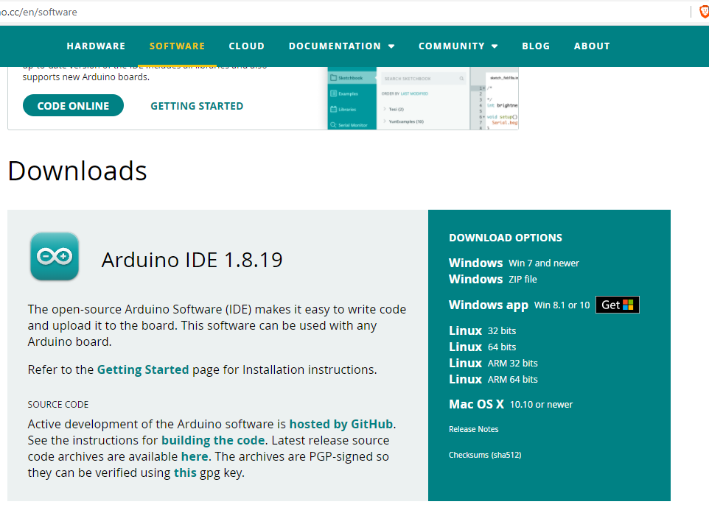
3. Principle of operation
Download the Arduino IDE
Download the Arduino IDE that is compatible with your computer system
Notes:
now we need download the arduino ide to test Lora

Slide 8
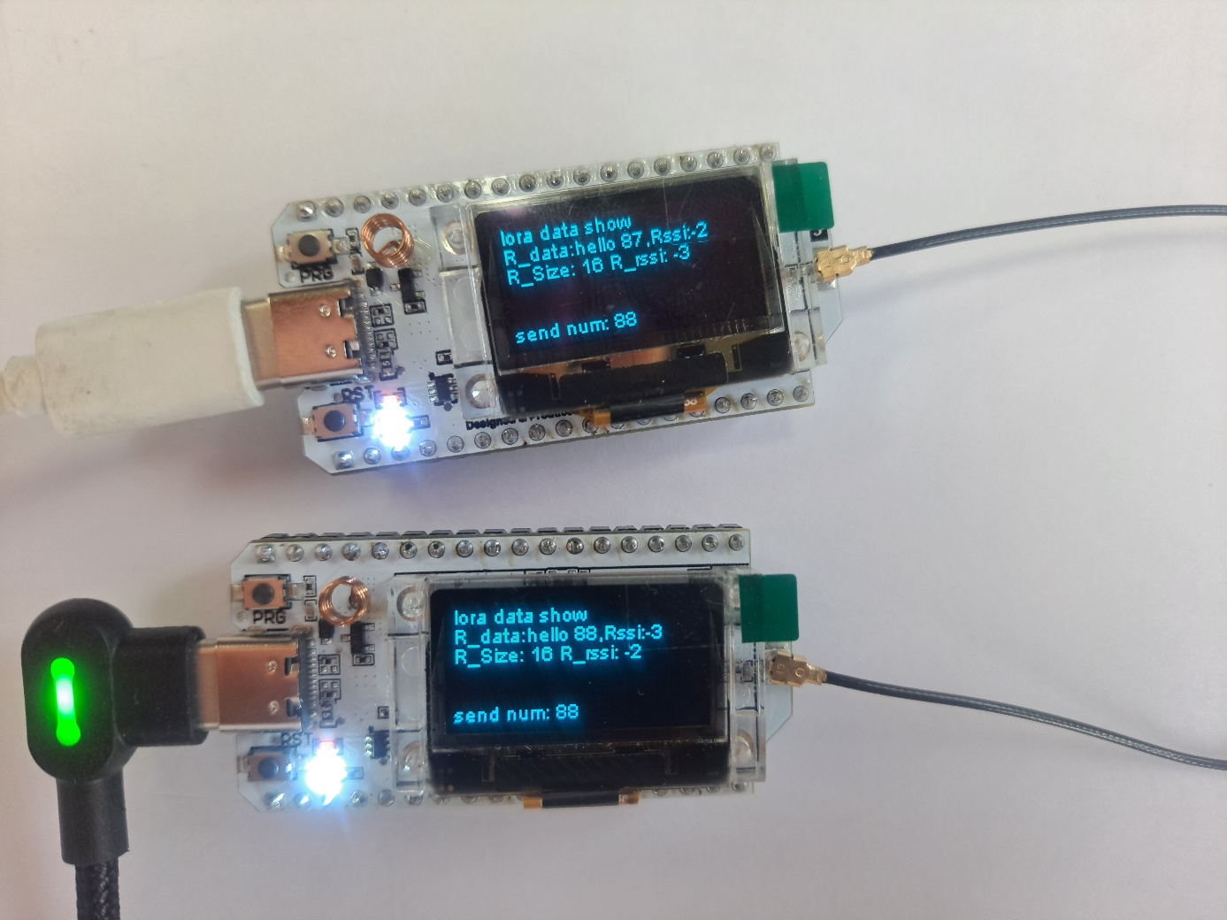
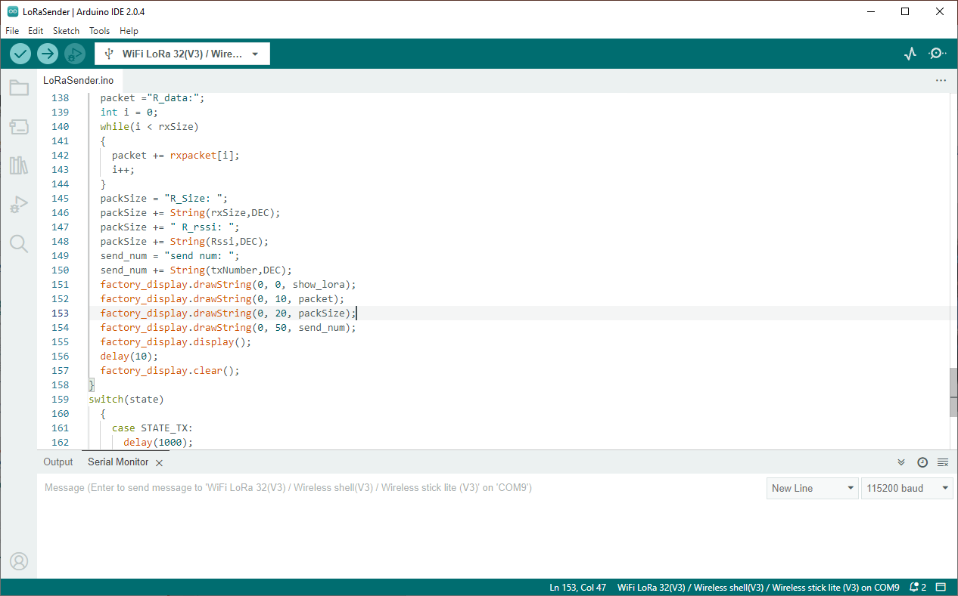
3. Principle of operation
Result
Notes:
The transmitter simply sends a traditional ‘Hello’ message to the receiver, which displays it in the Serial Monitor window.

Slide 9
4. Code and Code description
#include "Arduino.h"
#include "WiFi.h"
#include "LoRaWan_APP.h"
#include <Wire.h>
#include "HT_SSD1306Wire.h"
This section includes the necessary libraries for the Arduino board, WiFi, LoRaWAN, Wire (for I2C communication), and the SSD1306 OLED display.
#define RF_FREQUENCY 868000000 // Hz
#define TX_OUTPUT_POWER 10 // dBm
#define LORA_BANDWIDTH 0
#define LORA_SPREADING_FACTOR 7 // [SF7..SF12]
#define LORA_CODINGRATE 1 // [1: 4/5,
#define LORA_PREAMBLE_LENGTH 8 // Same for Tx and Rx
#define LORA_SYMBOL_TIMEOUT 0 // Symbols
#define LORA_FIX_LENGTH_PAYLOAD_ON false
#define LORA_IQ_INVERSION_ON false
This section defines various LoRa-related configuration parameters such as frequency, output power, bandwidth, spreading factor, coding rate, preamble length, symbol timeout, payload length, and IQ inversion. These parameters determine the behavior of the LoRa communication.
#define RX_TIMEOUT_VALUE 1000
#define BUFFER_SIZE 30 // char txpacket[BUFFER_SIZE];
char rxpacket[BUFFER_SIZE];
These lines define the receive timeout value and the buffer size for storing the transmitted and received packets.
static RadioEvents_t RadioEvents;
void OnTxDone( void );
void OnTxTimeout( void );
void OnRxDone( uint8_t *payload, uint16_t size,
int16_t rssi, int8_t snr );
These lines declare the RadioEvents structure and three callback functions: OnTxDone, OnTxTimeout, and OnRxDone. These functions are used to handle events related to LoRa communication.
Notes:
This is the libraries for bluetooth and OLED display.
This is the configuration of the wifi server on port 80
This is the oled display setup
These are variables that will be used to store data received over WiFi.

Slide 10
4. Code and Code description
void setup()
{
Serial.begin(115200);
delay(100);
factory_display.init(); factory_display.clear();
factory_display.display(); lora_init();
packet ="waiting lora data!";
factory_display.drawString(0, 10, packet);
factory_display.display();
}
The setup function is called once when the Arduino board starts. It initializes the serial communication, initializes and clears the OLED display, calls lora_init to initialize the LoRa module, sets the initial packet string for display, and shows it on the OLED display.
void loop()
{
if(resendflag){
state = STATE_TX;
resendflag = false; } if(receiveflag && (state==LOWPOWER) ){
receiveflag = false; packet ="R_data:"; int i = 0;
while(i < rxSize){
packet += rxpacket[i]; i++; }
packSize = "R_Size: "; packSize += String(rxSize,DEC);
packSize += " R_rssi: "; packSize += String(Rssi,DEC);
send_num = "send num: "; send_num += String(txNumber,DEC);
factory_display.drawString(0, 0, show_lora);
factory_display.drawString(0, 10, packet);
factory_display.drawString(0, 20, packSize);
factory_display.drawString(0, 50, send_num);
factory_display.display();
delay(10);
factory_display.clear();}
switch(state) {
case STATE_TX: delay(1000); txNumber++;
sprintf(txpacket,"hello %d,Rssi:%d",txNumber,Rssi);
Radio.Send( (uint8_t *)txpacket, strlen(txpacket) );
state=LOWPOWER; break;
case STATE_RX: Radio.Rx( 0 ); state=LOWPOWER; break;
case LOWPOWER: Radio.IrqProcess( ); break;
default: break;
}
}
The loop function is the main execution loop of the Arduino program. It checks if the resendflag is true, and if so, sets the state to STATE_TX to resend the packet. Then, it checks if the receiveflag is true and the state is LOWPOWER. If both conditions are met, it updates the display with the received packet data, packet size, RSSI, and send number. It then clears the flags and updates the OLED display.
The code then enters a switch-case block based on the current state. If the state is STATE_TX, it delays for 1 second, increments the transmit number, formats the transmit packet string with the transmit number and RSSI, and sends the packet using the LoRa radio module. It then sets the state to LOWPOWER.
If the state is STATE_RX, it sets the LoRa radio module to receive mode and sets the state to LOWPOWER.
If the state is LOWPOWER, it calls Radio.IrqProcess() to process any radio interrupts.
This loop continues executing indefinitely, repeatedly checking the conditions and performing the appropriate actions based on the current state.
Notes:
This section is Arduino setup section

Slide 11
Thank you for your consideration
Notes:
test manual is on the web. you can try it according to the instructions

