Slide 1
Chungbuk National University - 충북대학교
NRF24L01
Teaching assistant: 배일호
2023. 05.13

Slide 2
Contents
Block diagram
Hardware
Principle of operation
Code and code description

Slide 3
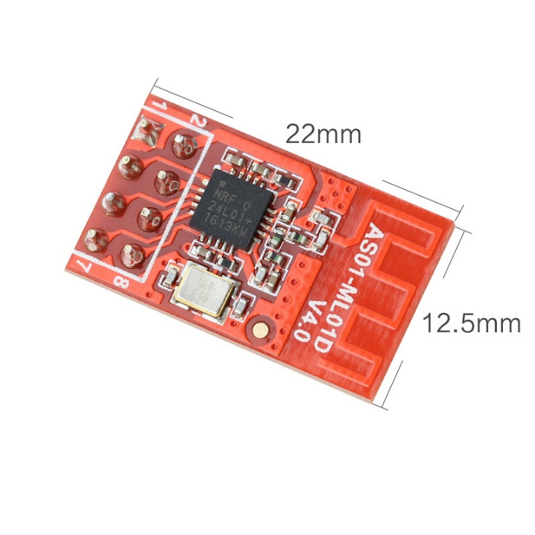
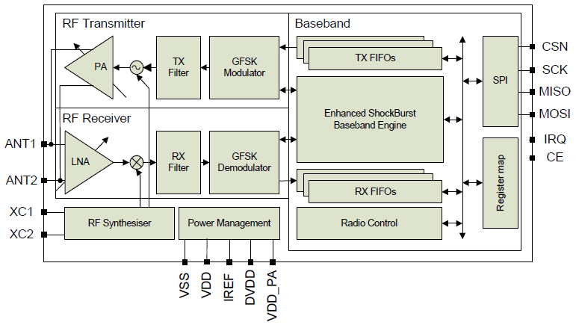
2. Block diagram
NRF24L01
Block diagram of NRF24L01
Notes:
The NRF24L01
The main functional blocks of the NRF24L01 module are the radio transceiver, the baseband processing unit, and the interface control logic.
is a wireless communication module that uses a complex protocol to transmit and receive data.
The radio transceiver is responsible for transmitting and receiving data over the air using the 2.4GHz frequency band. The SPI interface is used to send and receive data to and from the NRF24L01 module. The interface control logic uses the SPI interface to configure the module and manage the transmission and reception of data.

Slide 4
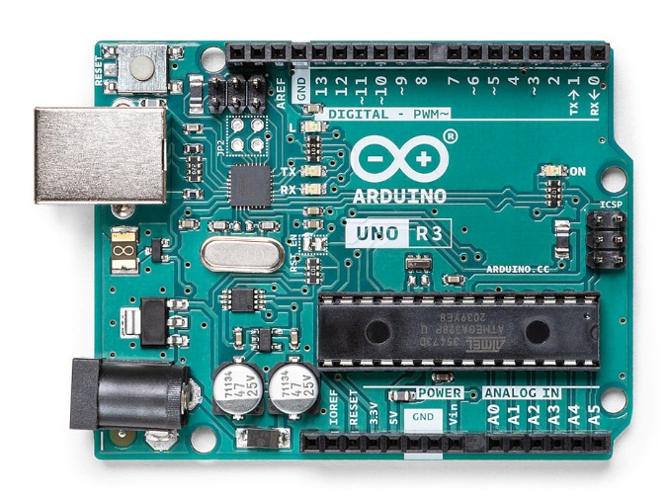
2. Hardware
something to use
Notes:
We need these things to test rf module
Arduino IDE, rf module, Arduino uno
we are going to program this board using arduino IDE

Slide 5
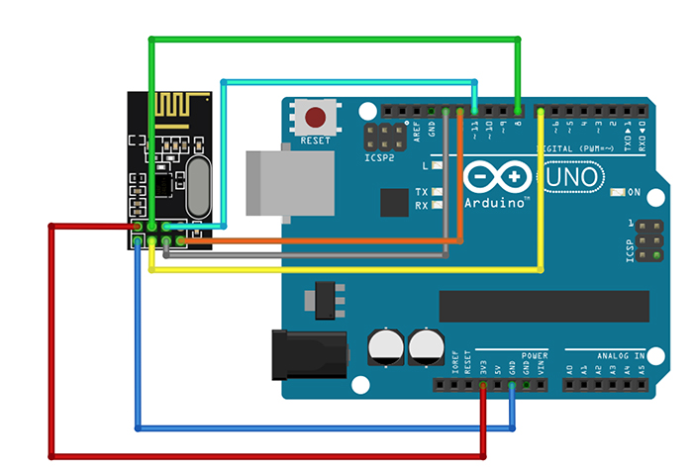
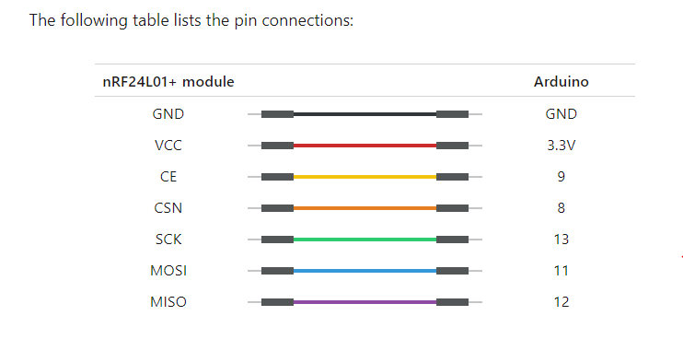
2. Hardware
Wiring a nRF24L01 module to an Arduino Uno
Notes:
connect the module’s VCC pin to Arduino’s 3.3V and the GND pin to ground. CSN and CE pins can be connected to any digital pin on an Arduino; in our case, they are connected to digital pins #8 and #9.
SPI pins. that each Arduino board has a unique set of SPI pins that must be connected accordingly. For Arduino boards such as the UNO/Nano V3.0, these pins are digital 13 (SCK), 12 (MISO), 11 (MOSI)

Slide 6
4. Principle of operation
The nRF24L01 module transmits and receives data on a specific frequency known as a channel. For two or more modules to communicate with each other, they must be on the same channel. This channel can have any frequency in the 2.4 GHz ISM band, or more precisely, any frequency between 2.400 and 2.525 GHz (2400 to 2525 MHz).
Each channel takes up less than 1 MHz of bandwidth. This gives us 125 possible channels with a 1MHz spacing.
This means that the nRF24L01+ can operate on 125 different channels, allowing you to build a network of 125 independently operating modems in one location.
Notes:
The nRF24L01+ module transmits and receives data on a specific frequency known as a channel. For two or more modules to communicate with each other, they must be on the same channel. This channel can have any frequency in the 2.4 GHz ISM band, or more precisely, any frequency between 2.400 and 2.525 GHz (2400 to 2525 MHz).
Each channel takes up less than 1 MHz of bandwidth. This gives us 125 possible channels with a 1MHz spacing.
This means that the nRF24L01+ can operate on 125 different channels, allowing you to build a network of 125 independently operating modems in one location.

Slide 7
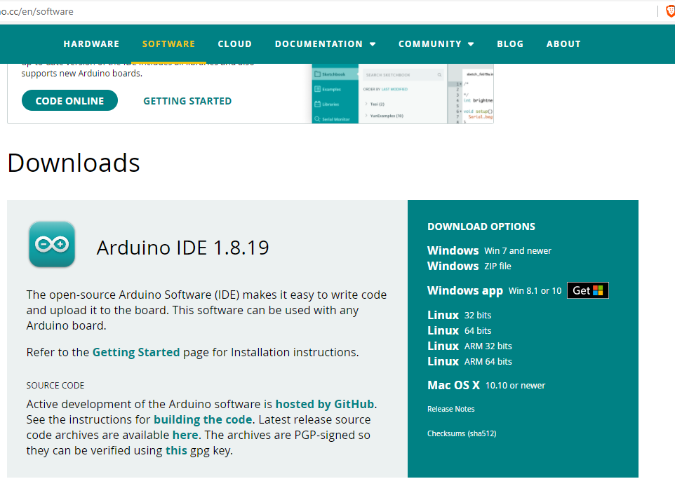
3. Principle of operation
Download the Arduino IDE
Download the Arduino IDE that is compatible with your computer system
Notes:
now we need download the arduino ide to test RF module

Slide 8
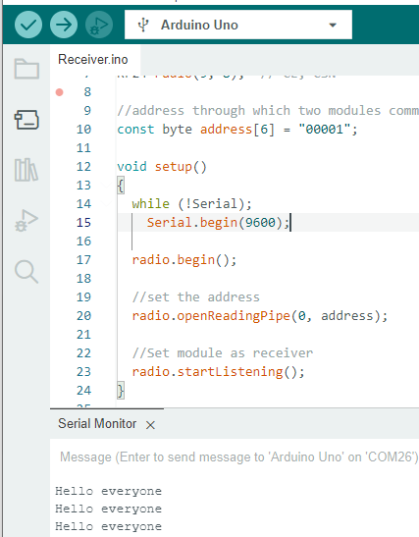
3. Principle of operation
Transmitter
Receiver
Result
Notes:
The transmitter simply sends a traditional ‘Hello’ message to the receiver, which displays it in the Serial Monitor window.

Slide 9
4. Code and Code description
#include <SPI.h>
#include <nRF24L01.h>
#include <RF24.h>
RF24 radio(9, 8); // CE, CSN
const byte address[6] = "00001";
char text[100]; bool stringComplete = false;
void setup(){
Serial.begin(9600);
radio.begin();
text[0] = 'H'; text[1] = 'e'; text[2] = 'l'; text[3] = 'l'; text[4] = 'o';
radio.openWritingPipe(address);
radio.stopListening();
}
void loop(){
radio.write(&text, sizeof(text));
delay(1000);}
void serialEvent() {
int i=0;
memset(text, 0, sizeof(text));
while (Serial.available()) {
char inChar = (char)Serial.read();
if (inChar == '\n'){
stringComplete = true;
}
else
text[i++] = inChar; // add it to the inputString:
}}
The sketch begins by including the necessary libraries. The SPI.h library handles SPI communication, while the nRF24L01.h and RF24.h libraries control the module.
The constructor of this object accepts two pin numbers as arguments, to which the CE and CSN signals are connected
we create a byte array to store the pipe address used by the two nRF24L01+ modules to communicate.
We use the write() function to send the message to the receiver. This function takes two arguments: the message to be sent and the number of bytes it contains.
This function is automatically called at the end of loop() when there is serial data available in the buffer.
Notes:
This is the libraries for bluetooth and OLED display.
This is the configuration of the wifi server on port 80
This is the oled display setup
These are variables that will be used to store data received over WiFi.

Slide 10
4. Code and Code description
The sketch begins by including the necessary libraries. The SPI.h library handles SPI communication, while the nRF24L01.h and RF24.h libraries control the module.
#include <SPI.h>
#include <nRF24L01.h>
#include <RF24.h>
RF24 radio(9, 8); // CE, CSN
const byte address[6] = "00001";
void setup()
{
while (!Serial);
Serial.begin(9600);
radio.begin();
radio.openReadingPipe(0, address);
radio.startListening();
}
void loop()
{
if (radio.available())
{
char text[32] = {0};
radio.read(&text, sizeof(text));
Serial.println(text);
}
}
The constructor of this object accepts two pin numbers as arguments, to which the CE and CSN signals are connected
we create a byte array to store the pipe address used by the
two nRF24L01+ modules to communicate.
The available() method is used in the loop section to check whether any data is available to be read. This method returns TRUE if data is available, FALSE otherwise.
Notes:
This section is Arduino setup section

Slide 11
Thank you for your consideration
Notes:
test manual is on the web. you can try it according to the instructions

