Slide 1
Chungbuk National University - 충북대학교
WiFi peer to peer and ESP_NOW
Teaching assistant: 배일호
2023. 04.21

Slide 2
Contents
Block diagram
Hardware
Principle of operation
Code and code description
Test results

Slide 3
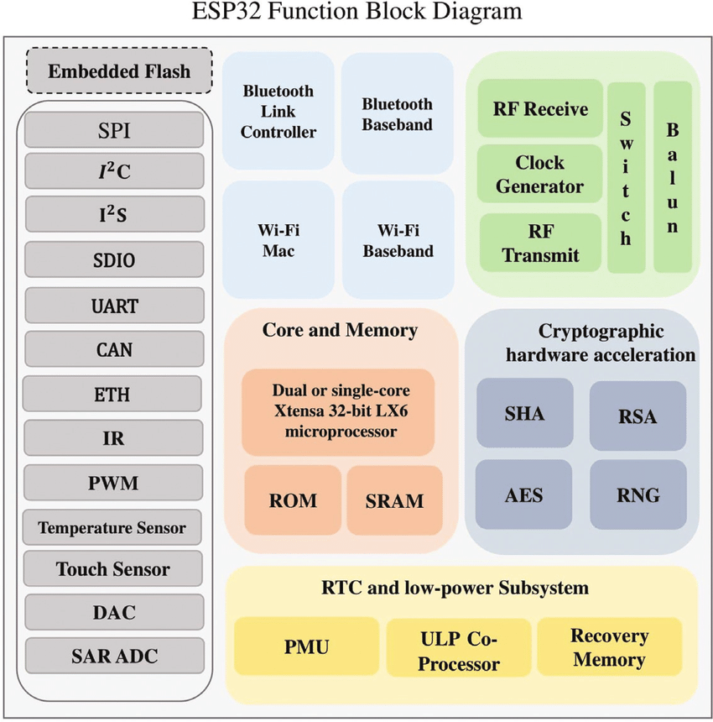
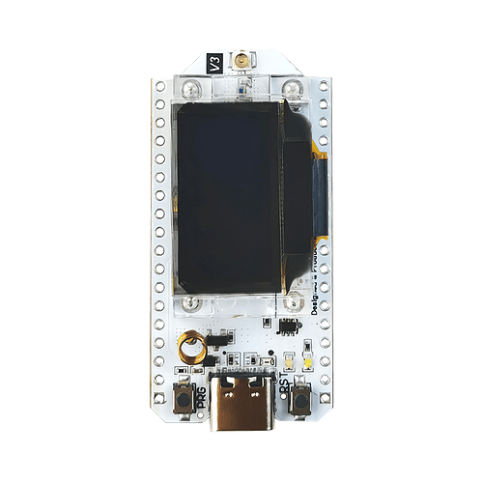
2. Block diagram
ESP32 V3 board
Block diagram of ESP32S3
Notes:
This is ESP32 V3 board
This board include esp32 chip
This is esp32 chip function block diagram.
This chip includes Bluetooth, wifi, embedded flash, RTC, and low power subsystem

Slide 4
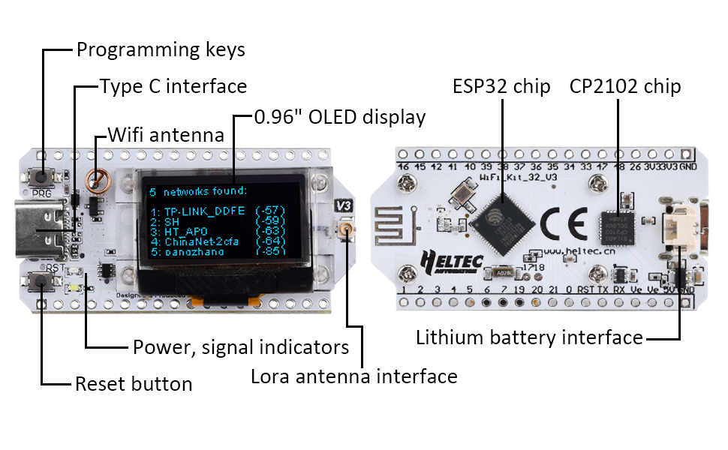
2. Hardware
Description of ESP32 v3 board
Notes:
Today we are going to use this board to test bluetooth peer to peer
This board includes esp32 chip, cp2102 chip, reset button, power and signal indicators, OLED diplay and type C interface

Slide 5
2. Hardware
something to use
Notes:
We need these things to test ESP p2p
Arduino IDE, 2 pieces of esp32v3 board
we are going to program this board using arduino IDE

Slide 6
4. Principle of operation
ESP-NOW
WiFi Peer-to-Peer and ESP-NOW are two different protocols that can be used for wireless communication between devices.
WiFi Peer-to-Peer (WiFi Direct) is a standard developed by the WiFi Alliance that allows devices to connect to each other without the need for a wireless access point (router). With WiFi P2P, two or more devices can connect directly to each other and communicate using the WiFi radio.
ESP-NOW is a protocol developed by Espressif Systems that allows for low-power, low-latency communication between ESP32 and ESP8266 devices using the 2.4GHz radio. ESP-NOW is designed for scenarios where devices need to communicate with each other directly, without the need for an access point or other infrastructure..
Both WiFi P2P and ESP-NOW can be used for wireless communication between devices, but they have different strengths and weaknesses. WiFi P2P is a more versatile protocol that can be used with any WiFi-enabled device, while ESP-NOW is designed specifically for communication between ESP32 and ESP8266 devices.
The choice between WiFi P2P and ESP-NOW depends on the specific requirements of your project. If you need to connect to non-ESP devices or require more versatile networking capabilities, WiFi P2P may be the better option. If you are working within the ESP32 or ESP8266 ecosystem and require fast and reliable communication between devices, ESP-NOW may be the better choice.
Notes:
WiFi Peer-to-Peer and ESP-NOW are two different protocols that can be used for wireless communication between devices.
WiFi Peer-to-Peer (WiFi Direct) is a standard developed by the WiFi Alliance that allows devices to connect to each other without the need for a wireless access point (router). With WiFi P2P, two or more devices can connect directly to each other and communicate using the WiFi radio. This can be useful for creating ad-hoc networks between devices or for establishing a direct communication channel between two devices without the need for a central access point.
ESP-NOW is a protocol developed by Espressif Systems that allows for low-power, low-latency communication between ESP32 and ESP8266 devices using the 2.4GHz radio. ESP-NOW is designed for scenarios where devices need to communicate with each other directly, without the need for an access point or other infrastructure. ESP-NOW is particularly useful for applications that require fast and reliable communication between devices, such as wireless sensor networks or home automation systems.
Both WiFi P2P and ESP-NOW can be used for wireless communication between devices, but they have different strengths and weaknesses. WiFi P2P is a more versatile protocol that can be used with any WiFi-enabled device, while ESP-NOW is designed specifically for communication between ESP32 and ESP8266 devices. ESP-NOW offers faster and more reliable communication than WiFi P2P, but it is limited to use within the ESP32 and ESP8266 ecosystem.
In summary, the choice between WiFi P2P and ESP-NOW depends on the specific requirements of your project. If you need to connect to non-ESP devices or require more versatile networking capabilities, WiFi P2P may be the better option. If you are working within the ESP32 or ESP8266 ecosystem and require fast and reliable communication between devices, ESP-NOW may be the better choice.

Slide 7
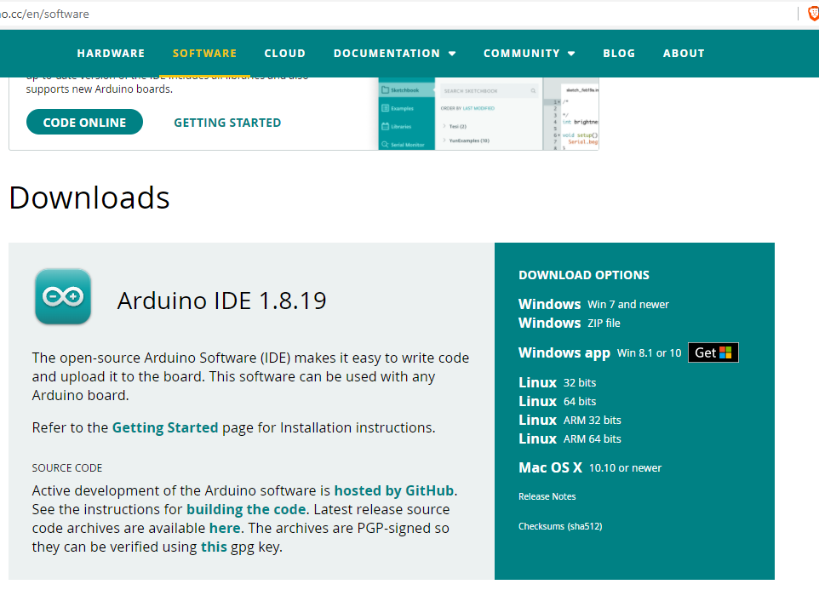
3. Principle of operation
Download the Arduino IDE
Download the Arduino IDE that is compatible with your computer system
Notes:
now we need download the arduino ide to test ESP_NOW

Slide 8
4. Code and Code description
#include <Arduino.h>
#include <WiFi.h>
#include <esp_wifi.h>
#include <QuickEspNow.h>
#include "HT_SSD1306Wire.h"
#include <stdlib.h>
#include <string>
This section includes several libraries needed for the program to run.
SSD1306Wire display(0x3c, 500000, SDA_OLED, SCL_OLED, GEOMETRY_128_64, RST_OLED);
This line creates an object of the SSD1306Wire class, which is used to control the OLED display.
int sCount = 1, numCount = 0;
String sDatas[8];
These variables are used to store data received over ESP-NOW.
static const String msg = "Hello Device 1"; static uint8_t receiver[] = {0xDE, 0xAD, 0xBE, 0xEF, 0xFE, 0xED};
#define DEST_ADDR receiver const unsigned int SEND_MSG_MSEC = 2000;
These variables are used to set up the message that will be sent over ESP-NOW
void dataReceived(uint8_t *address, uint8_t *data, uint8_t len, signed int rssi, bool broadcast) { ... }
This is a callback function that will be called whenever data is received over ESP-NOW.
Notes:
This is the libraries for bluetooth and OLED display.
This is the oled display setup
this section is Service and characteristic IDs of Bluetooth setting
this class is a callback class for Bluetooth
if you send data from your phone to an esp32 board, this class will be activated

Slide 9
4. Code and Code description
void setup()
{
display.init();
display.setFont(ArialMT_Plain_10);
display.setTextAlignment(TEXT_ALIGN_LEFT);
display.drawString(50, 0, "Test");
display.display(); Serial.begin(115200);
WiFi.mode(WIFI_MODE_STA);
uint8_t mac[] = {0xDE, 0xAD, 0xBE, 0xEF, 0xFE, 0xED};
esp_wifi_set_mac(WIFI_IF_STA, mac); WiFi.disconnect(false, true);
quickEspNow.onDataRcvd(dataReceived);
quickEspNow.setWiFiBandwidth(WIFI_IF_STA, WIFI_BW_HT20);
quickEspNow.begin(1); }
This function is called once when the program starts up. It sets up the OLED display and WiFi module, sets the MAC address of the WiFi module, and sets up the ESP-NOW communication.
void loop()
{
static unsigned int counter = 0; String message = String(msg) + " " + String(counter++);
if (!quickEspNow.send(DEST_ADDR, (uint8_t *)message.c_str(), message.length()))
{ Serial.println(">>>>>>>>>> Message sent");
} else {
Serial.println(">>>>>>>>>> Message not sent");
} delay(SEND_MSG_MSEC);}
This function is called repeatedly as long as the program is running. It sends a message over ESP-NOW every SEND_MSG_MSEC milliseconds
Notes:
This section is Arduino setup section

Slide 10
7. Test result
If 2 devices are connected, data will be sent between the 2 devices.
The data will be printed on the screen as shown in the figure above.
Notes:
If I send data from my phone to the esp32 board, the data will be printed on the screen

Slide 11
Thank you for your consideration
Notes:
test manual is on the web. you can try it according to the instructions

