Slide 1
Chungbuk National University - 충북대학교
Bluetooth peer to peer
Teaching assistant: 배일호
2023. 03.24

Slide 2
Contents
Block diagram
Hardware
Principle of operation
Code and code description
Test results

Slide 3
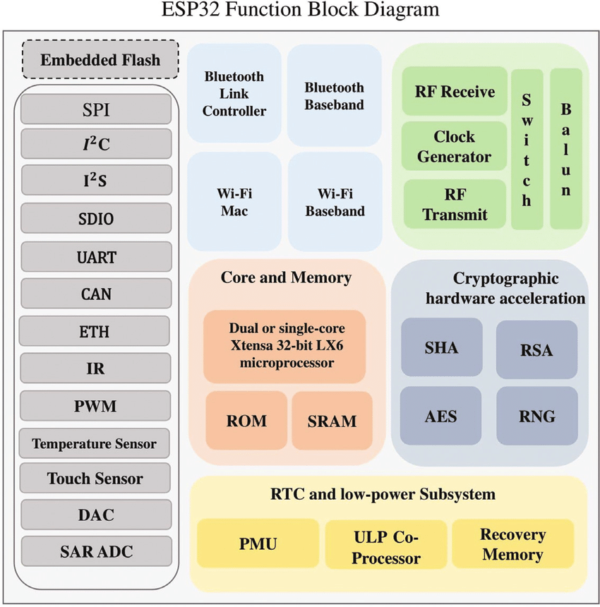
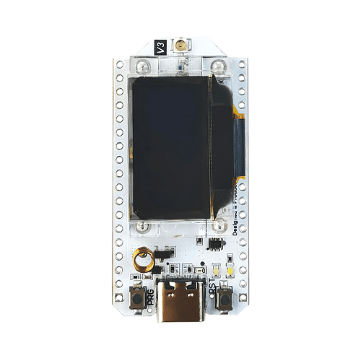
2. Block diagram
Block diagram of ESP32S3
Notes:
This is esp32s3 function block diagram. This board has Bluetooth, wifi, embedded flash, RTC and low-power subsystem
Today we are going to use Bluetooth of this board

Slide 4
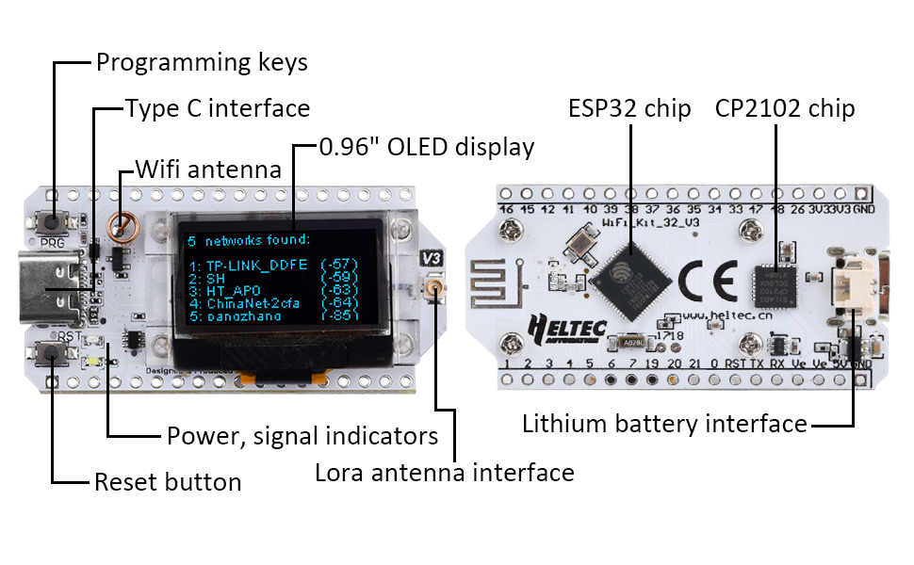
2. Hardware
Description of ESP32 version 3 board

Slide 5
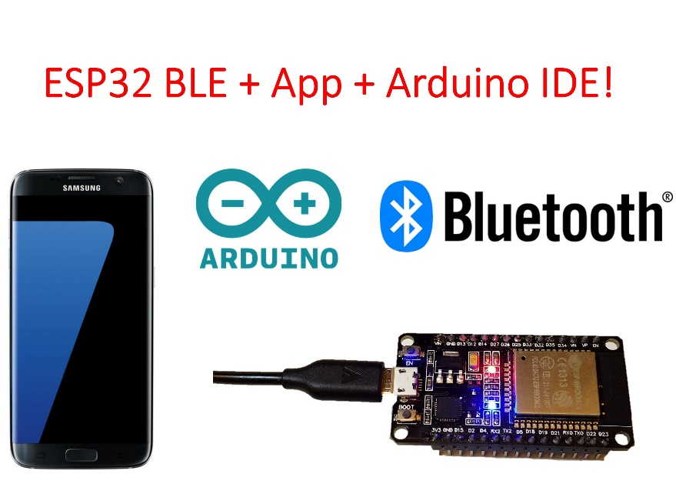
2. Hardware
things to use

Slide 6
4. Principle of operation
Bluetooth peer-to-peer communication allows two Bluetooth-enabled devices to establish a direct connection without the need for an intermediary device, such as a Wi-Fi router or cellular network. This connection is typically established using a Bluetooth radio frequency, which enables devices to communicate wirelessly over short distances.
To initiate a peer-to-peer connection, both devices must be within range and have their Bluetooth functionality turned on. Once the devices are paired, they can communicate directly with each other using Bluetooth profiles, such as the Object Push Profile (OPP) or the Personal Area Networking Profile (PAN). These profiles enable devices to share files, transfer data, and even stream audio or video content between each other.

Slide 7
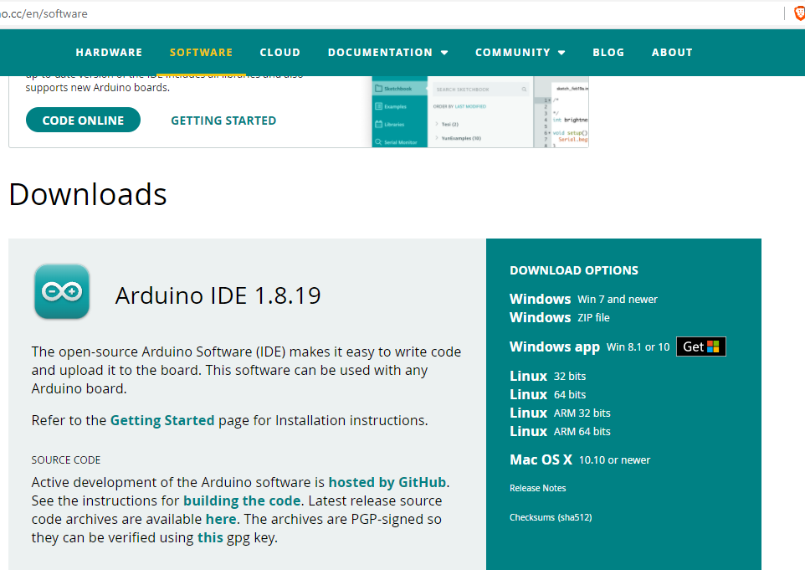
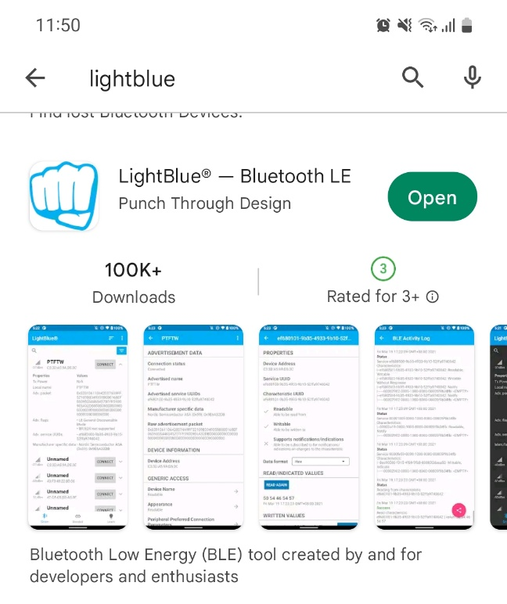
3. Principle of operation
Download the Arduino IDE and android application
Download the Arduino IDE that is compatible with your computer system

Slide 8
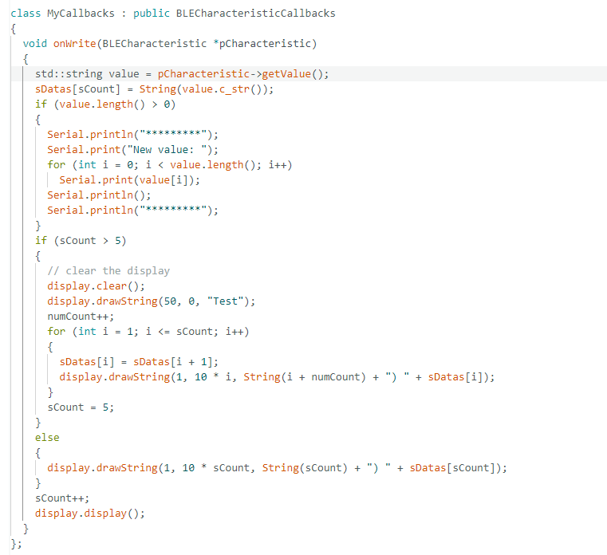
4. Code and Code description
Include these libraries
Set the OLED display
variables to use
Service and characteristic IDs are for Bluetooth setting
this class is a callback class for Bluetooth
if you send data from a phone to an esp32 board, this class will be activated

Slide 9
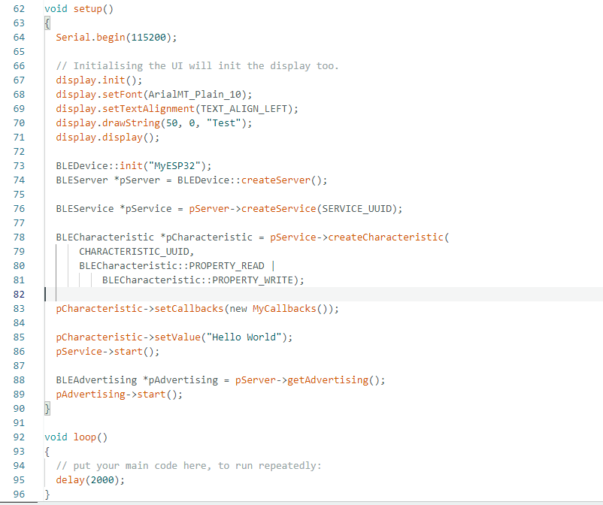
4. Code and Code description
set up Serial monitor, ESP32 Bluetooth and OLED display

Slide 10
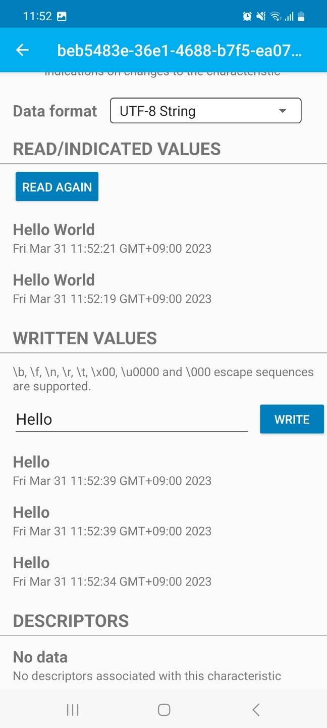
7. Test result

Slide 11
Thank you for your consideration

