Slide 1
Chungbuk National University - 충북대학교
UHF RFID
AEL Laboratory
2023.03.11

Slide 2
Contents
1. The basics of UHF RFID
2. Block diagram
3. Specifications
4. Principle of operation

Slide 3
1. The basics of UHF RFID
RFID writer
Writers write to change using the data that old stored on the tags, often, simply an identifier such as the Electronic Product Code (EPC) but possibly historical or other cached information.
Name | Description
UHF (Ultra High Frequency) | Frequencies: 0.3-3 GHz
 | Read range: up to 12 m(40 feet)
 | Comply with the global, universally adopted UHF Gen2 ISO 18000-63
 | Work frequencies range: 860-960 MHz
 | Cheapest tag to manufacture

Slide 4
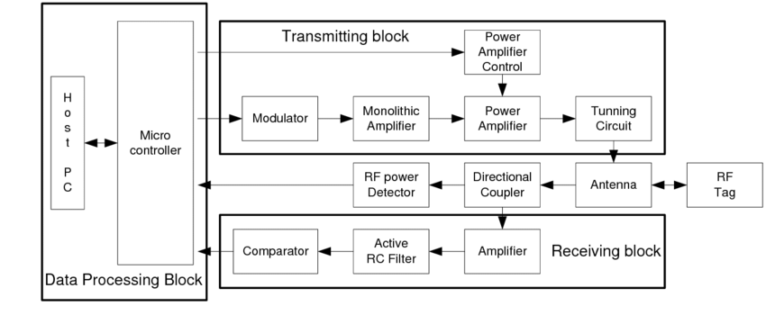
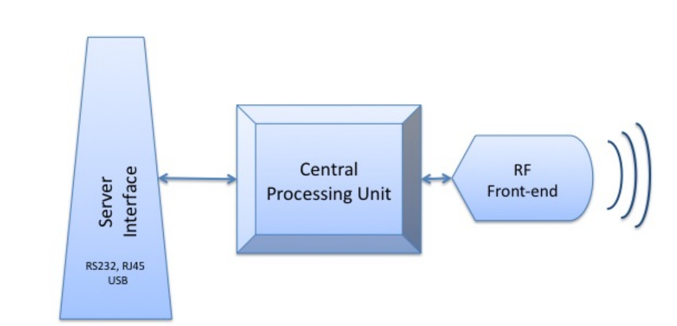
2. Block diagram
Fig 1. Block diagram of RFID work principle.

Slide 5
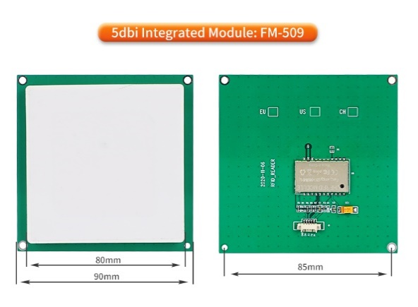
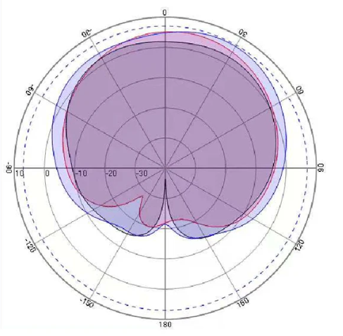
3. Specifications
모델 | FM-505
프로토콜 | ISO18000-6C / EPC C1 GEN2
주파수 | 865-868MHZ(EU),902-928MHZ (미국)
RF 출력 | -2 ~ 25dBm
인터페이스 | TTL(UART)
이득 안테나 | 3dbi 안테나
모듈 크기 | 50*50mm
거리 | 2.5M (태그에 따라 다름)
읽기 속도 | > 50pcs 태그/sec
태그 저장 | 200pcs 태그 @ 96 비트 EPC
전원 | 3.3V-5V
대기 현재 | <80mA(EN 핀 고수준)
잠자는 전류 | <100uA(EN 핀 저수준)
가동 현재 | 180mA @ 3.5V(25dBm 산출, 25 ℃)
 | 110mA @ 3.5V (-2 dBm 출력, 25 °C)
수신 감도 | <70dbm
방열 방법 | 공기 냉각 (밖으로 설치를 위한 필요 없음 냉각 탄미익)

Slide 6
3. Specifications
Parameter | Symbol | Min. | Typ. | Max. | Unit
RF Output Frequency for reader | Fc | 860 | - | 960 | Mhz
RF Output Power | Pout | - | - | 26.5 | dbm
RF Transmission setup time | TRF_OUT | - | - | 0.5 | ms
RF Frequency error | Ferror | - | - | 1000 | ppm
Interrogator Transmit Spurious Emissions, In-Band | In accordance with local regulations |  |  |  | -
Interrogator Transmit Spurious Emissions, Out of-Band | In accordance with local regulations |  |  |  | -
RF Bandwidth | In accordance with local regulations |  |  |  | -
Transmit data rate | TRate | - | 26K | - | bps
Modulation | ASK
Modulation depth | 90% normally
Data Coding | PIE
Demodulation | ASK
Download data rate | DRate | - | 40K | - | bps
Data encoding | FM0
Power consumption:
Parameter | Symbol | Min. | Typ. | Max. | Unit
Power Supply voltage | VIN | 3.6 | 5 | 5.5 | V

Slide 7
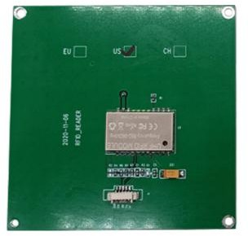
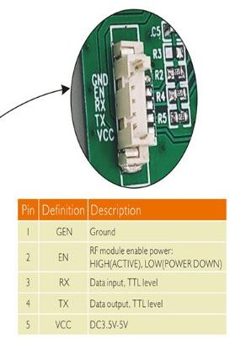
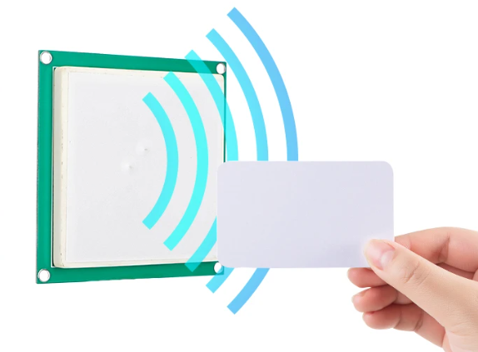
3. Pinout
Front of FM-505
Rear of FM-505
Fig 4. RFID tag

Slide 8
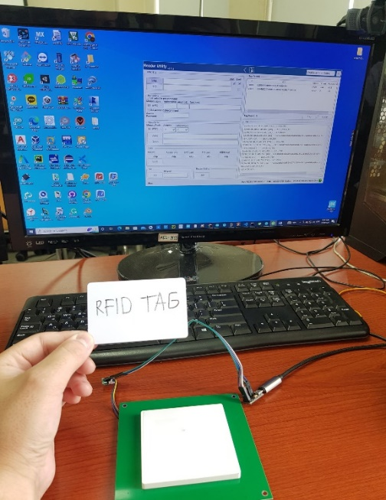
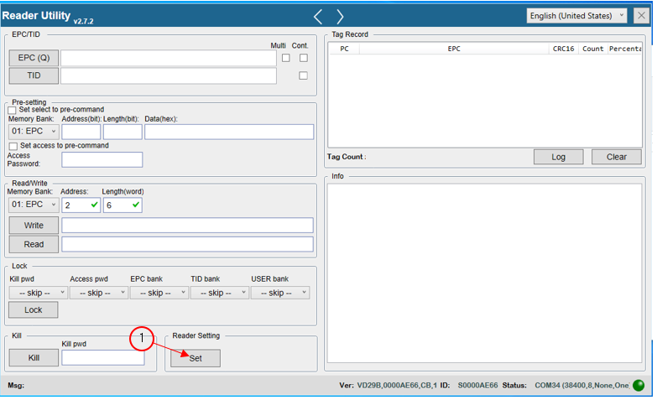
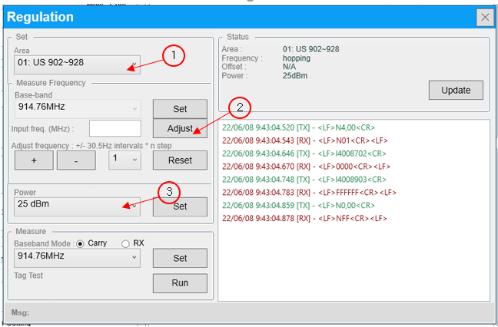
4.Principle of operation

Slide 9
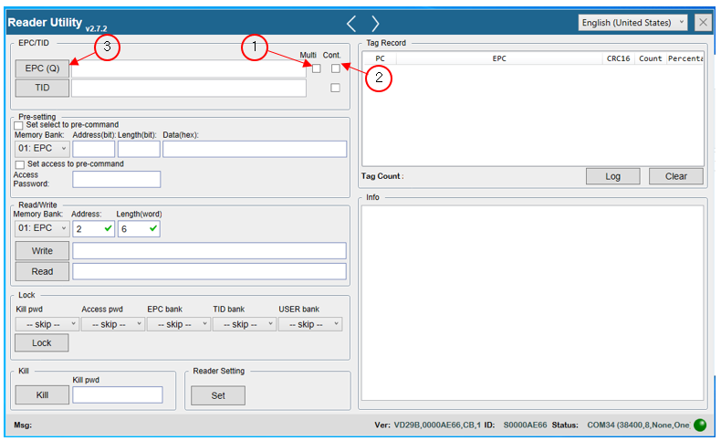
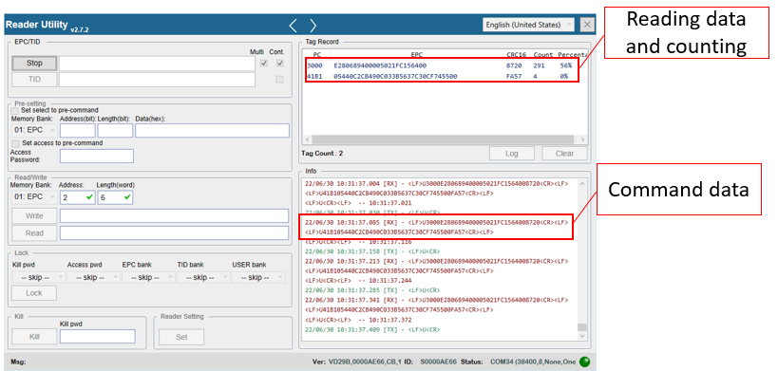
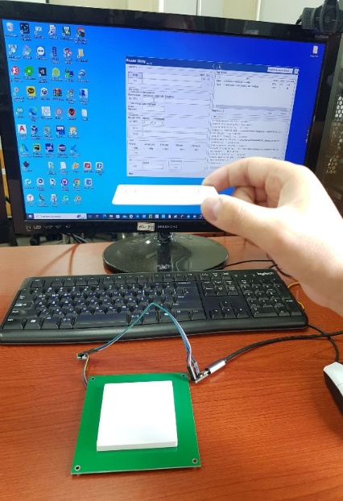
4.Principle of operation

Slide 10
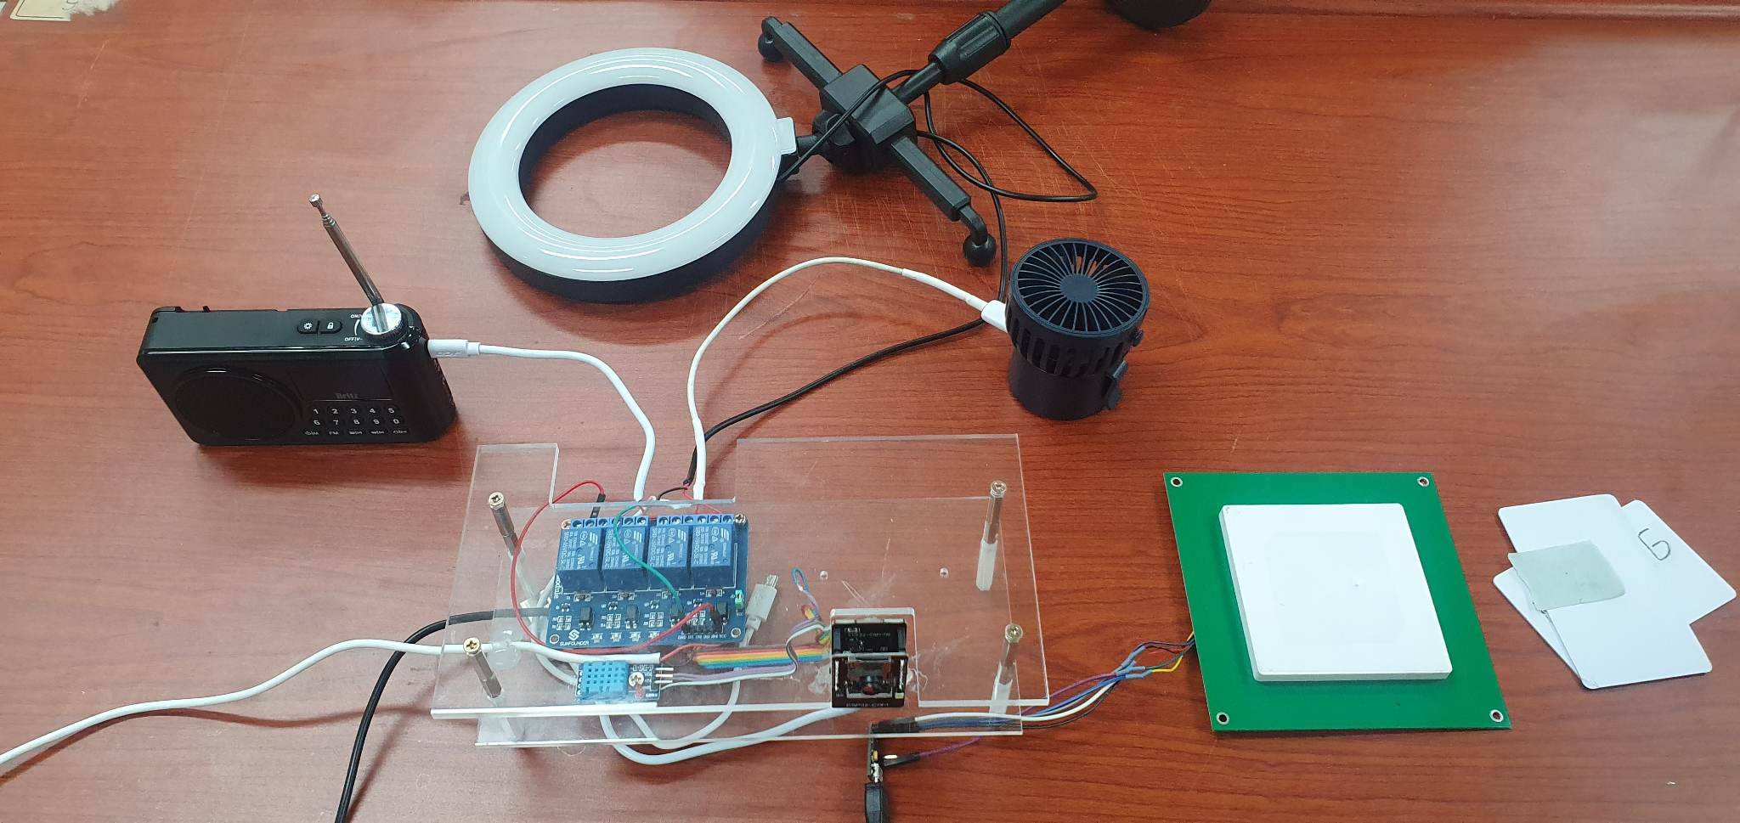
4.Principle of operation
Relay control using by RFID
RFid
tags
Relay

